Slide 1
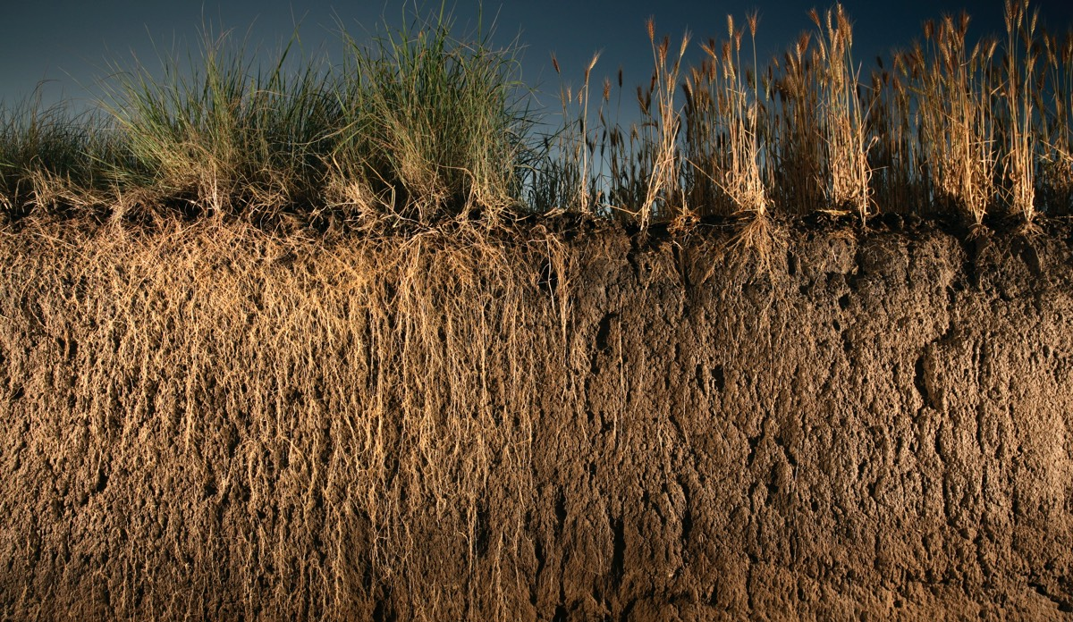



What is soil health and why does it matter for climate resilience?
Created by Hannah Rodgers
Fall 2025

Slide 2

What we eat, other than what comes out of the oceans, is all derived from the soil. Soil security is equal to food security.
– Jerry Hatfield, Living Soil Film
There can be no life without soil and no soil without life; they have evolved together.
- Dr. Charles E Kellogg

Slide 3
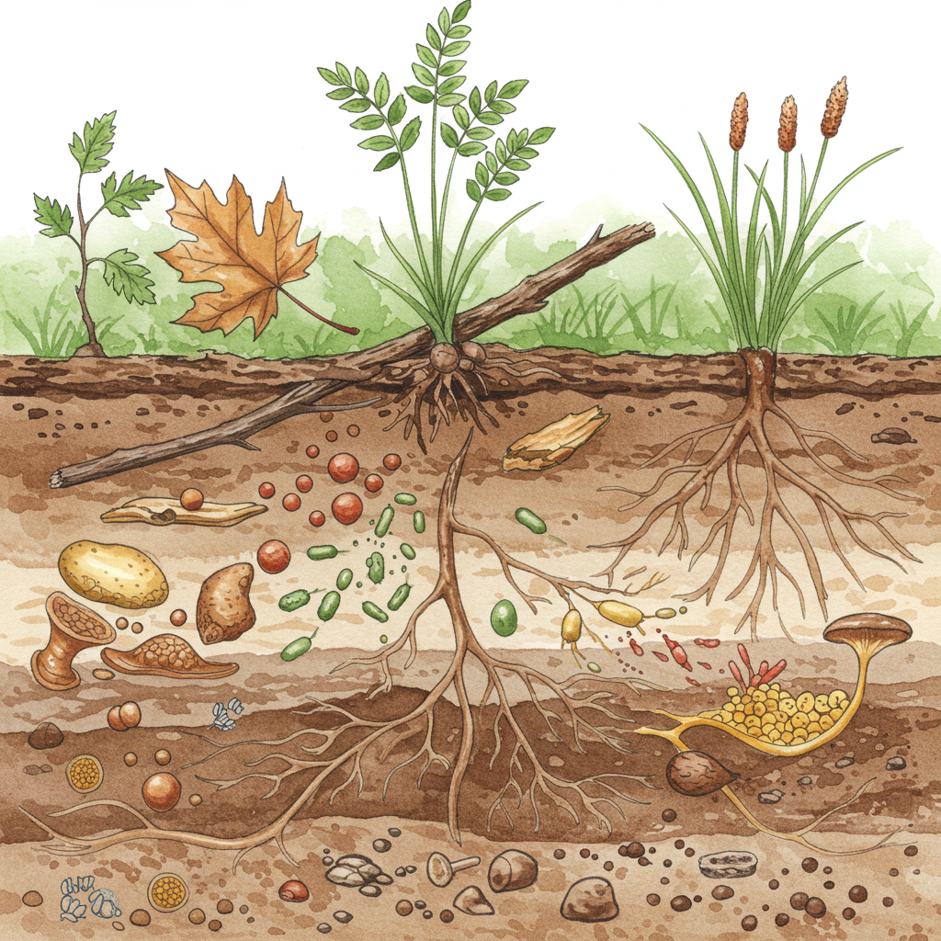
How can you tell if a soil is healthy?
How does soil affect plants & animals?
Notes:
Phenomenon-based questions to ask. Have students answer these questions in groups and record some ideas in their notebooks, then share with the class.

Slide 4
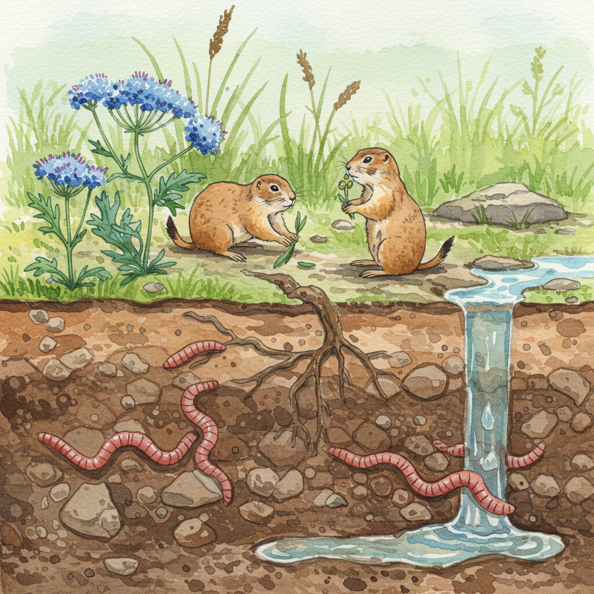
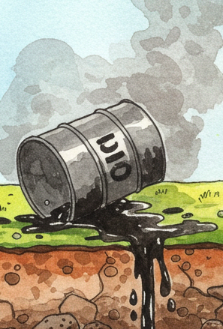
Soil is the Foundation of a Healthy Ecosystem!
Five Functions of a Healthy Soil:
Air & Water Filtration
Habitat & Biodiversity
NO₃
Stability & Resisting Erosion
Nutrient Cycling
Water Storage
Notes:
Store water: A healthy soil easily soaks up water and can store that water for many months, helping plants survive drought.
Think of your yard: is it still green after 2 days without rain? 2 weeks? 2 months?
Cycle nutrients: Microorganisms that live in the soil eat dead plants and animals and turn them into nutrients for living things - this is decomposition!
What happens to dead plants and animals that are on the ground?
Provide stability: Health soil is stable. It won’t blow away in the wind or wash away in a storm, and it can support plant roots, buildings, and other structures. Think about how strong a soil has to be to hold up a tree!
Think about a nearby hill or riverbank. What would if that hill was just loose sand? What would happen during a big storm? What would happen to any buildings or plants on that hill?
Filter toxins and pollutants from our air and water: Soil particles absorb harmful things from our air and water, and microbes living in soil break down these toxins. When your dog pees on the soil, that pee gets filtered so that by the time it reaches the aquifer below, it’s just clean water!
What happens when animals pee onto the soil? That pee trickles through the soil and ends up in our streams - is it still pee when it reaches our streams? Why not?
Supports habitat and biodiversity: Thousands and thousands of plants and animals live in the soil, from tiny bacteria and fungi (like mushrooms) and to bigger animals like earthworms and gophers, as well as plants! These soil-living creatures form the bottom of the food chain that everything else relies on.
Can you think of some animals that live in the soil?

Slide 5
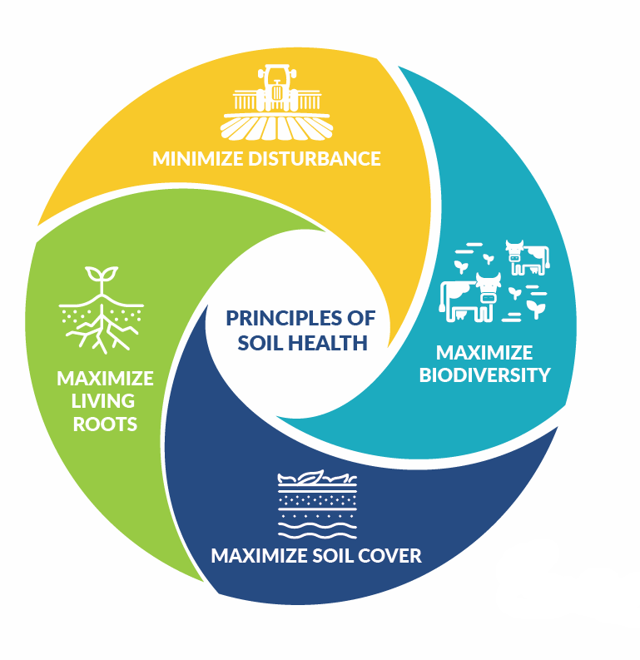
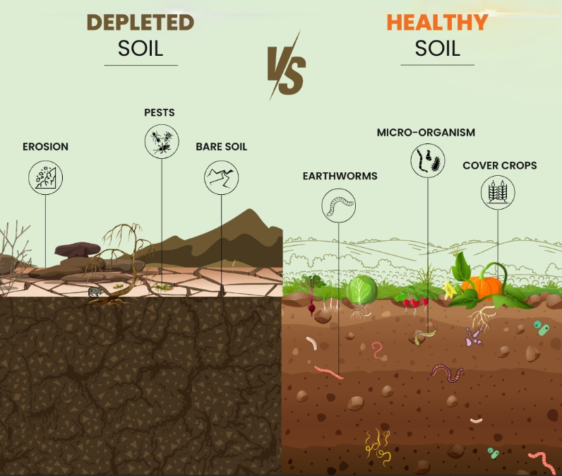
Farming practices impact soil health!
Reduce tillage * Grow cover crops or perennials * Integrate livestock* Rotate crops * Create areas for wildlife & pollinators
Notes:
When a soil isn’t healthy, it can’t complete those five functions! That can cause problems with erosion, pests, crop disease, and drought.
These four principles tell us how we can support soil health in a managed ecosystem, like a farm or a garden.
(for an ag-informed classroom): What are some examples of practices that support these principles?
Minimize disturbance: reduce tillage
Maximize living roots & maximize soil cover: Cover crops, perennials
Maximize biodiversity: Rotate crops, integrate livestock, create areas for wildlife & pollinators

Slide 6
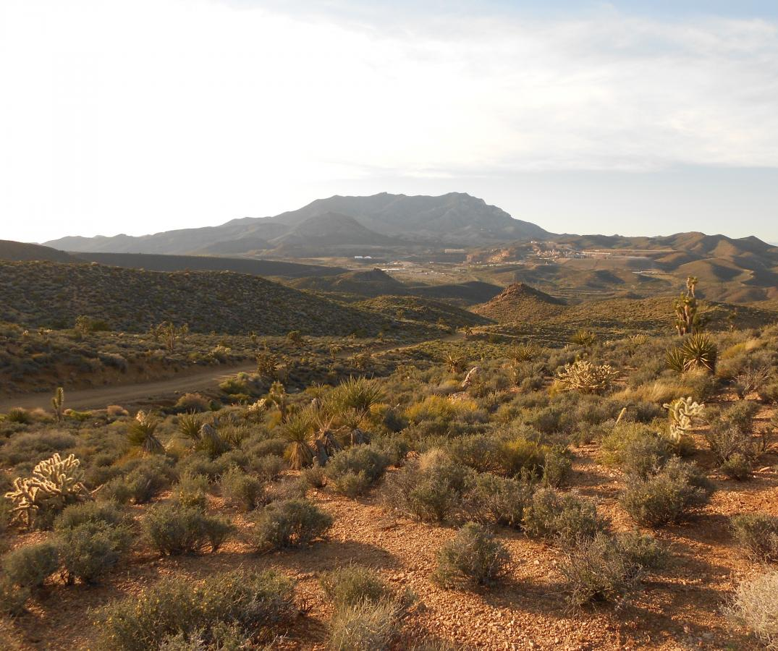
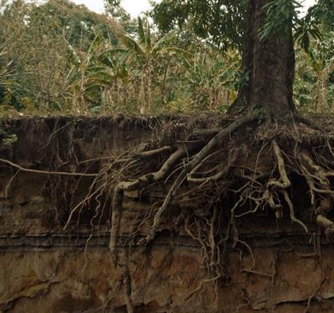
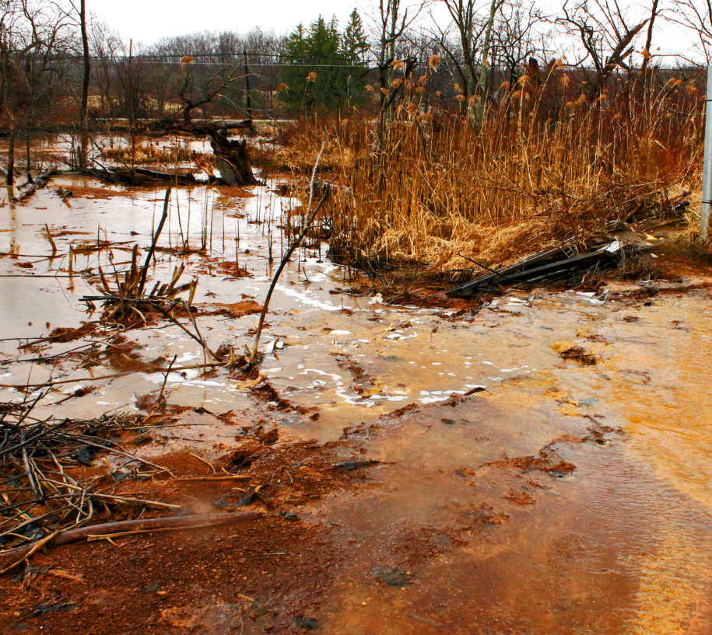
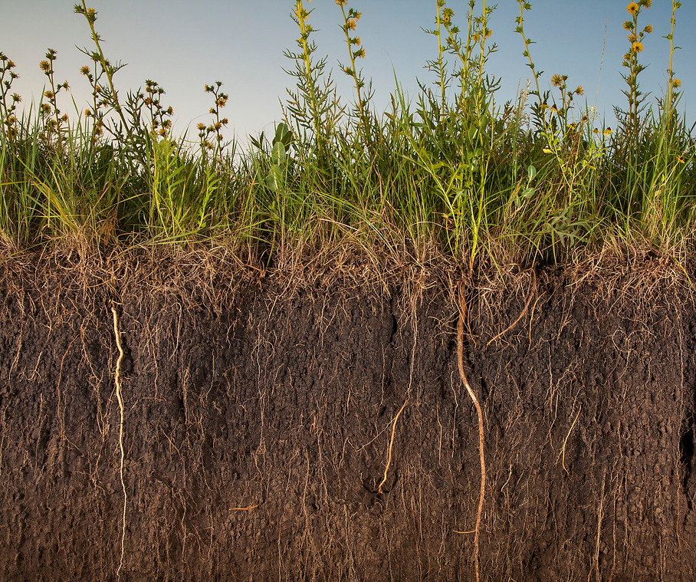
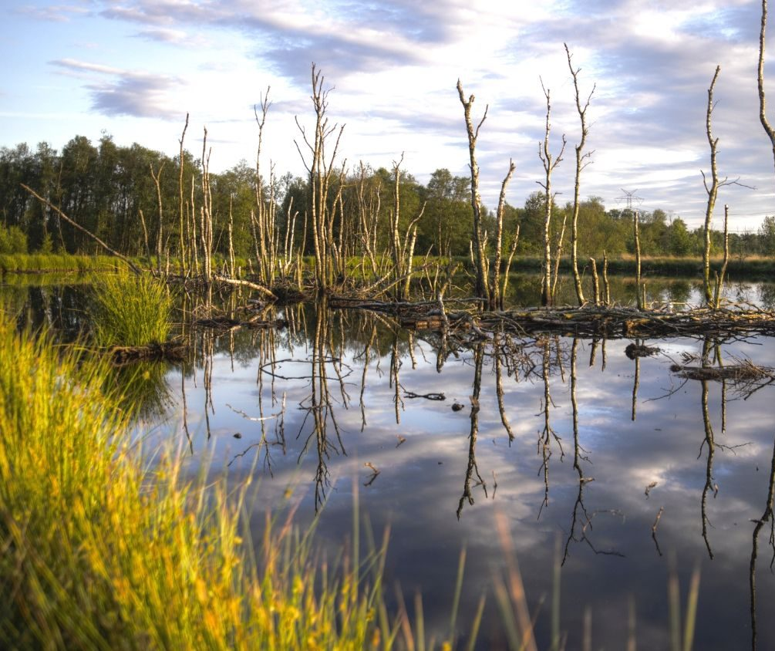
Soil health depends on the ecosystem!
What soil functions do these ecosystems DEMONSTRATE?
Desert
Forest
Agriculture
Wetland
Mining Site
Notes:
Soil health differs depending on the environment! All ecosystems perform those 5 soil functions differently.
Possible answers:
Desert: preventing erosion, water storage
Forest: biodiversity & habitat
Mining site: filtering air & water
Agriculture: Cycling nutrients
Wetland: Storing water

Slide 7
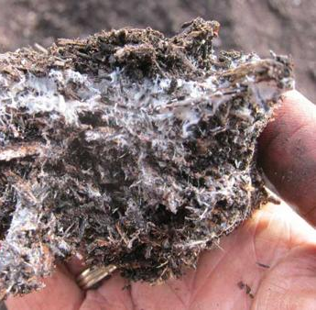
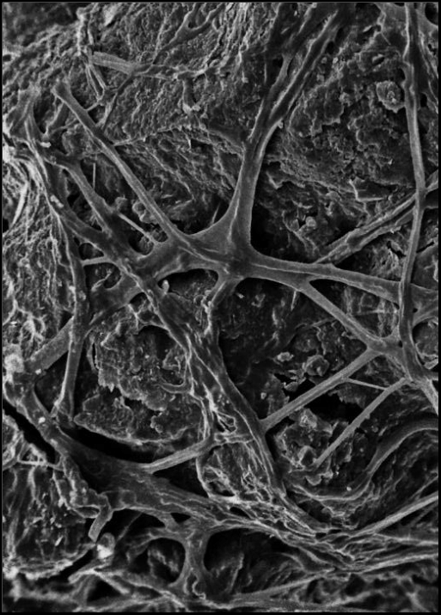
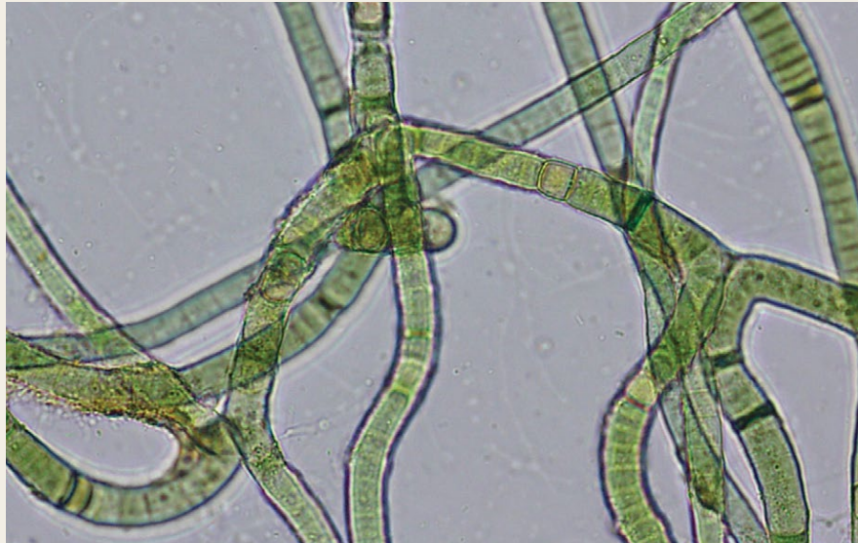
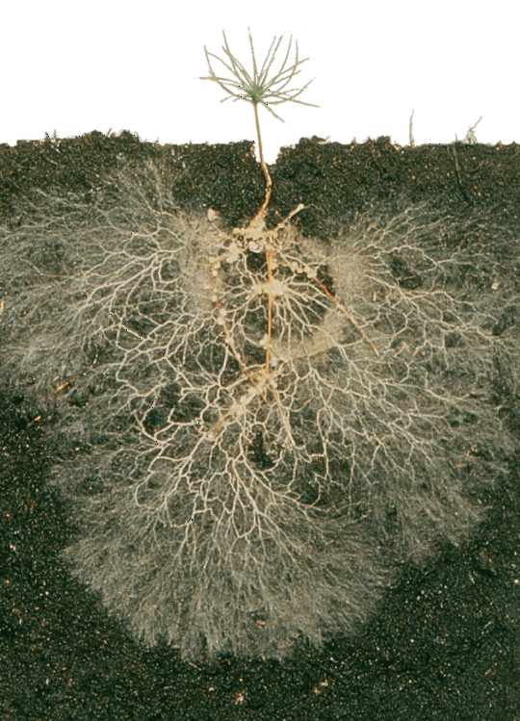
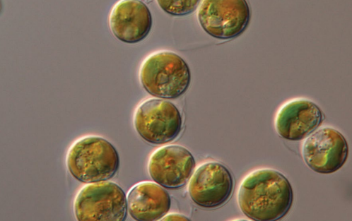
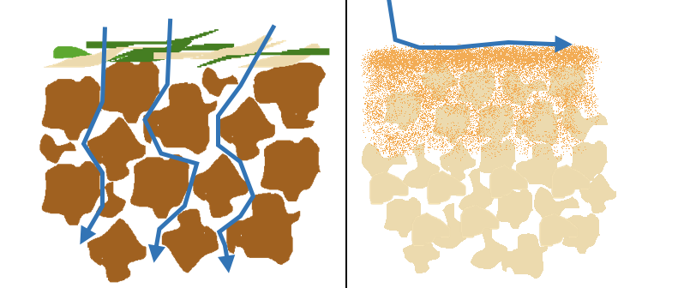
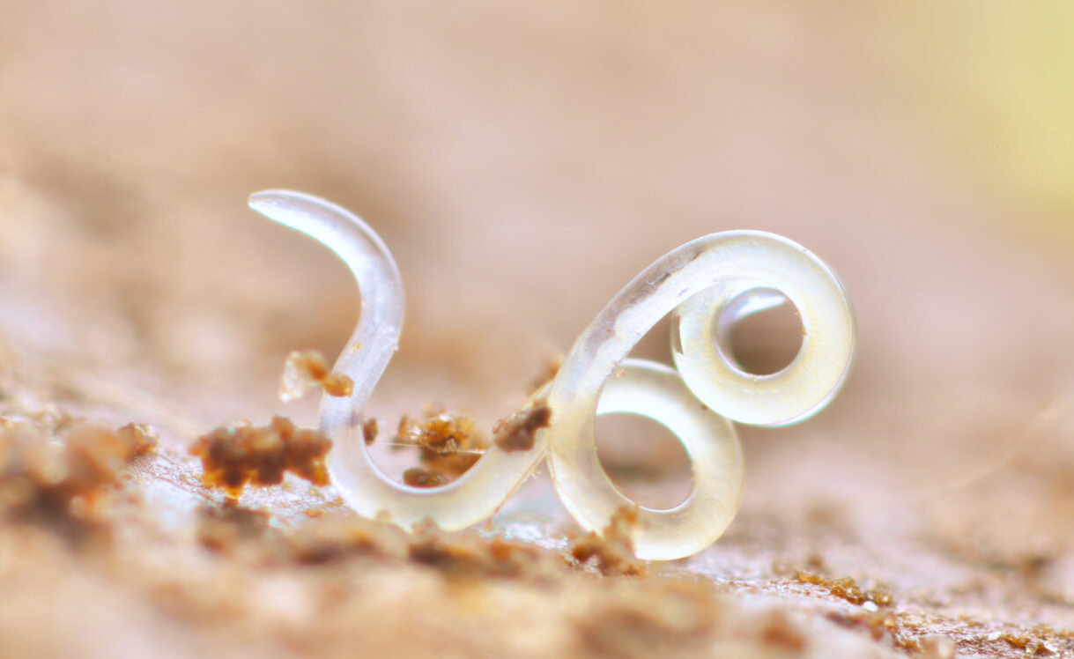
Soil Health Depends on Microorganisms
Microbes help with:
Aggregation!
Microbes help with:
Nutrient & water uptake
Soil is a sponge ☺ Soil is a brick ☹
4 / 5 of all animals on earth are nematodes!
Notes:
(Optional Slide)
Microorganisms, like bacteria and fungi, are important to all five soil functions! One spoon of soil contains BILLIONS of microbes, like this fungus (top L), bacteria (middle L), and tiny animals like this nematode (bottom L).
Fun fact: There are so many nematodes that ⅘ of all animals on earth are nematodes!
Pine seedling: This white fuzzy stuff is a fungus that grows on a plant roots and helps the plant access nutrients and water. Fungi in the soil also help soil form aggregates (little balls) that build good strong soil structure.
A soil with good structure acts like a sponge: it soaks up water and nutrients, holds lots of air, and is nice and soft for plant roots and worms to dig down into it.
A soil with bad structure is like a brick: Water and nutrients might just run off the surface, and it can be hard for plant roots to dig down into it.
Soil microorganisms are an important part of building that healthy soil sponge.

Slide 8
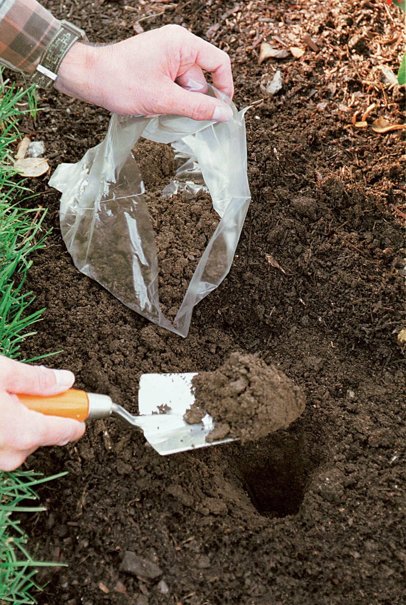
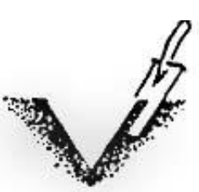
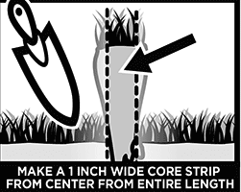
x
Time to Collect Soils!
Each group of 2 students needs:
2 Ziploc bags, labelled “healthy” or “unhealthy”
Something to dig with (pocket knife, spade)
How to collect a soil sample:
Each group will collect two soil samples: one they predict is “healthy” and one they predict is “unhealthy”
Brush away plant debris, gravel, woodchips, etc covering the soil surface
Dig to the same depth at both sites
Collect even cores across depths (not a pizza slice)
Collect ~1 cup of soil per site
Notes:
Send students outside in groups of two or three, with two plastic bags and something to dig with (ideally a spade, but a butter knife can work fine). Tell them to return within 15 minutes.
Ask students to collect one soil that they think is healthy and put it into one bag, and one that they think is unhealthy and put it into the other bag. Let students explore and discuss what THEY think is a healthy soil- it’s ok if they’re wrong.
(Hint: Good places to find unhealthy soil could be by a road or sidewalk - somewhere nothing is growing. Good places to find healthy soil could be under trees or in planted areas).

Slide 9
Make this chart in your notebook!
 | “Healthy” Soil | “Unhealthy” Soil | Notes
Organic Matter
Texture
pH
Nitrate
Where did you healthy soil sample come from?
What made you think it was healthy?
Where did your unhealthy soil sample come from?
What made you think it was unhealthy?
Notes:
Make this table and answer these questions in your notebooks!

Slide 10
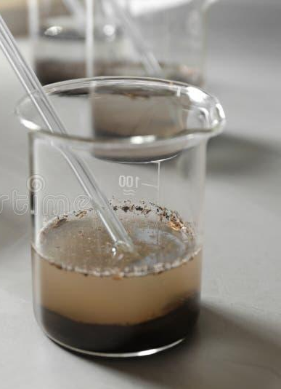

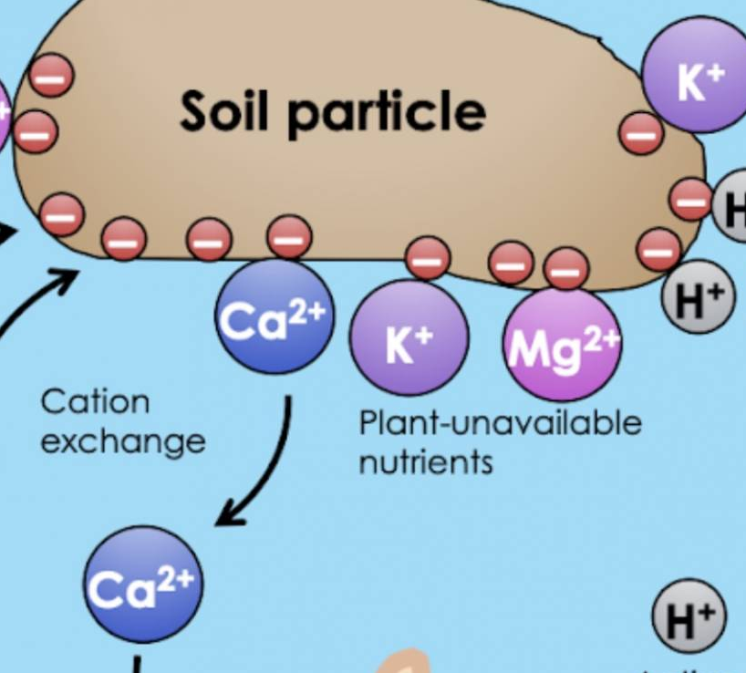
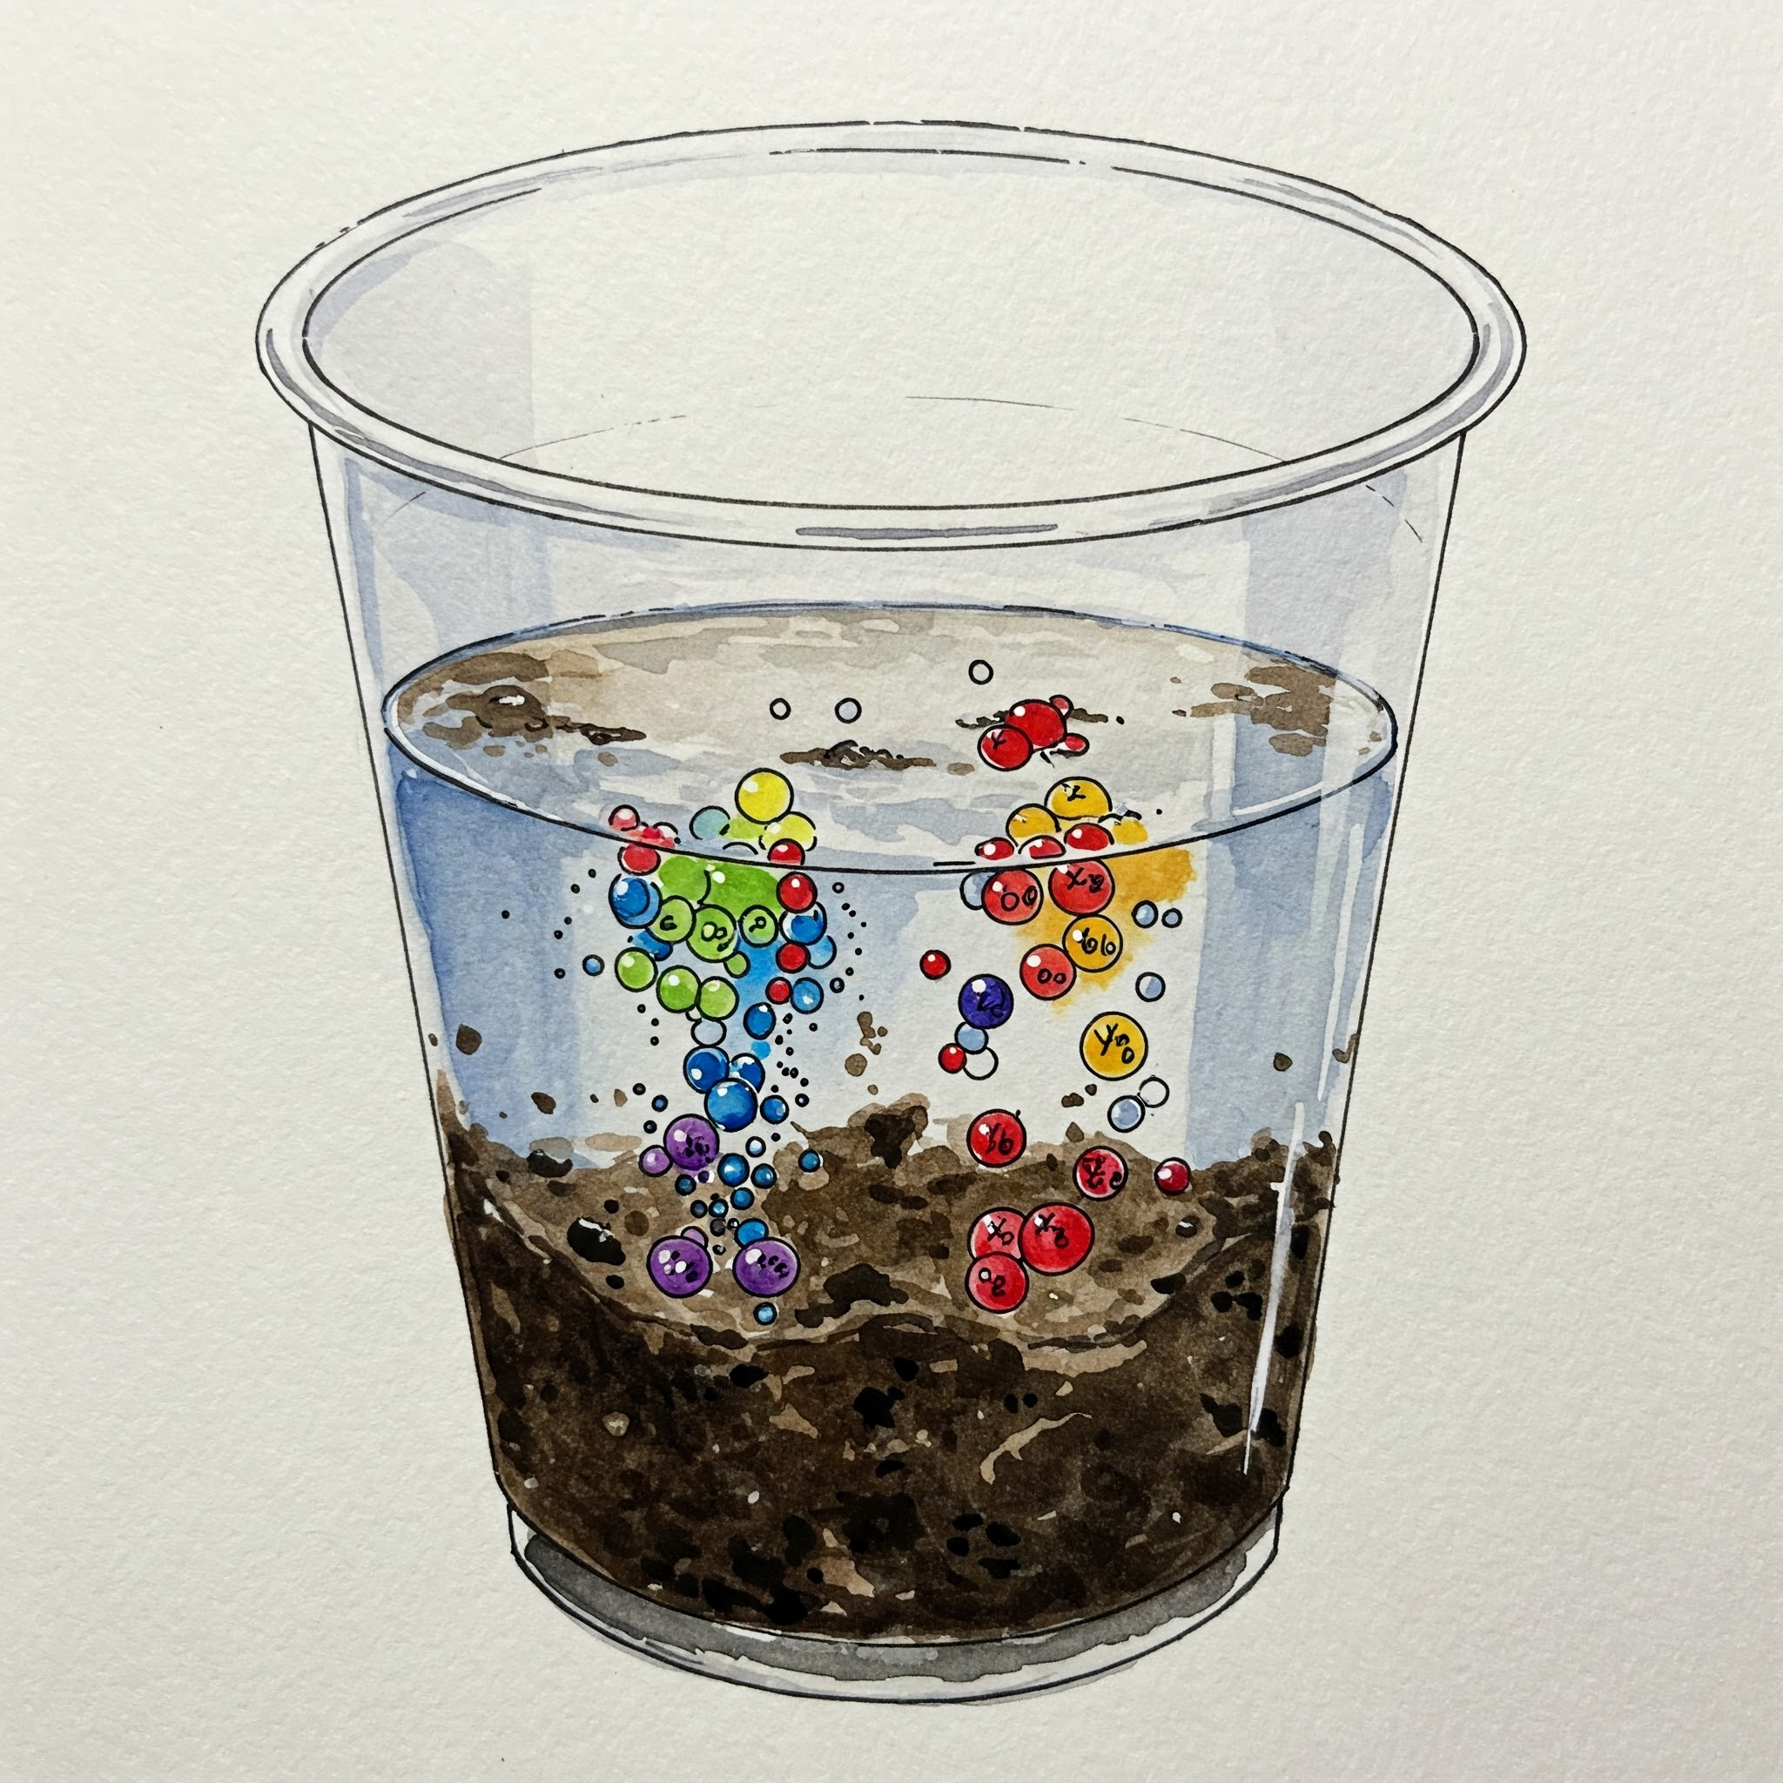
Make a soil slurry
Fill cup ¼ with soil, ¼ with water
Stir for 2 minutes!
Let settle- we’ll be testing the water on top, which now contains dissolved ions from the soil
Notes:
Do this step for each soil sample (each group should have 2 cups of soil).

Slide 11
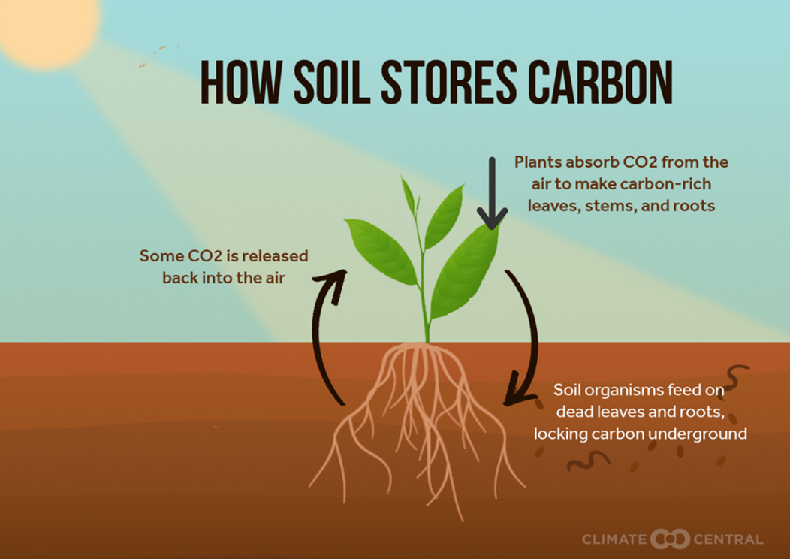
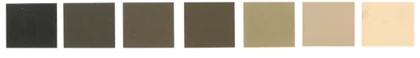
TEST 1: Soil Organic Matter by Color
Made of decomposed plants, animals, and microbes
Contributes to all five soil functions!
Resists drought: Every 1% increase in organic matter holds an extra inch of rain!
Moisten your soil, choose what color it resembles most, record the percent organic matter
Organic Matter
(percent)
Color
(moist soil)
5% 3.5% 2.5% 2% 1.5% 1% 0.5%
Notes:
TEST: Moisten a small piece of soil and compare it to the color chart.

Slide 12
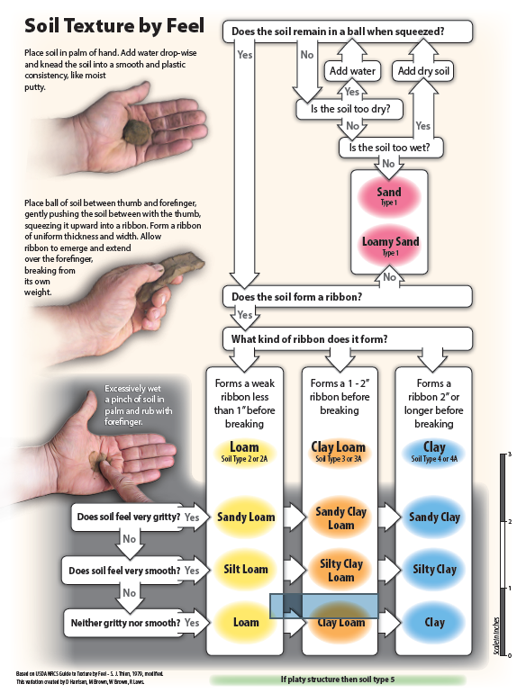
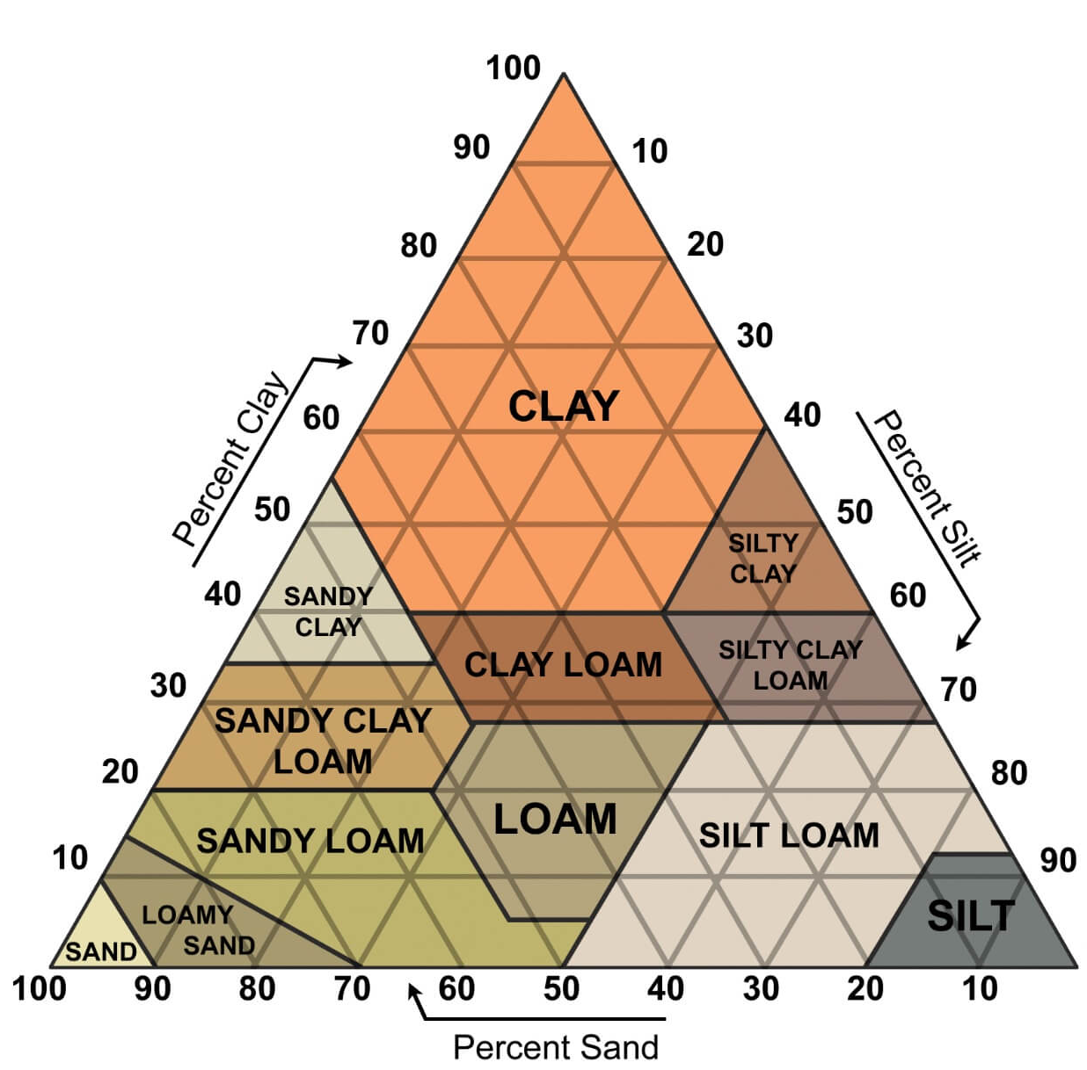
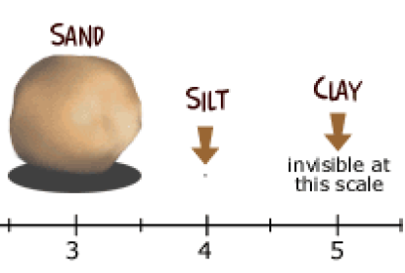
TEST 2: Soil Texture
3 sizes of soil particles:
mm
Sandy soils: good drainage, poor water-holding
Clayey soils: good water-holding, poor drainage
Ideal soil: mixture of sand, silt, and clay (loam!)
Record your soil’s texture
Notes:
Soil particles are named by size: sand particles are the biggest, silt particles are medium, and clay particles are TINY! (way too small to see with your eye). How much clay, silt, and sand is in our soil determines many of its properties and functions.
Soil texture and water:
Think about a sandy beach: does water flow into the soil easily? Does the sand hold onto that water, or does it leak out? What about clay? If you pour water onto clay, does it soak in or run off the top?
(sandy soils absorb water well but don’t hold onto it. Clayey soils DON’T absorb water well, but they hold water- they can stay wet for a long time.)
An ideal soil has a mixture of sand, silt, and clay: this type of soil is called a loam. Farmers like loam soils because they store water, hold onto organic matter and nutrients, and are soft enough for roots to grow easily through them.
TEST: Go through the flowchart and figure out your soils texture!
Watch this demonstration video if needed: https://www.youtube.com/watch?v=GWZwbVJCNec&ab_channel=UCDavisIPO

Slide 13
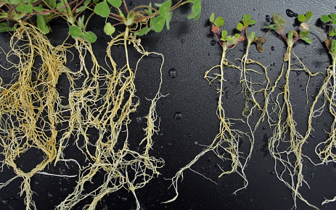
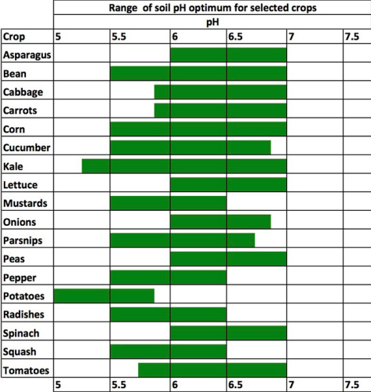
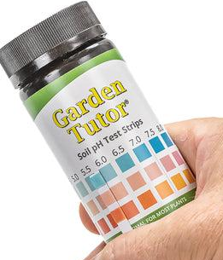
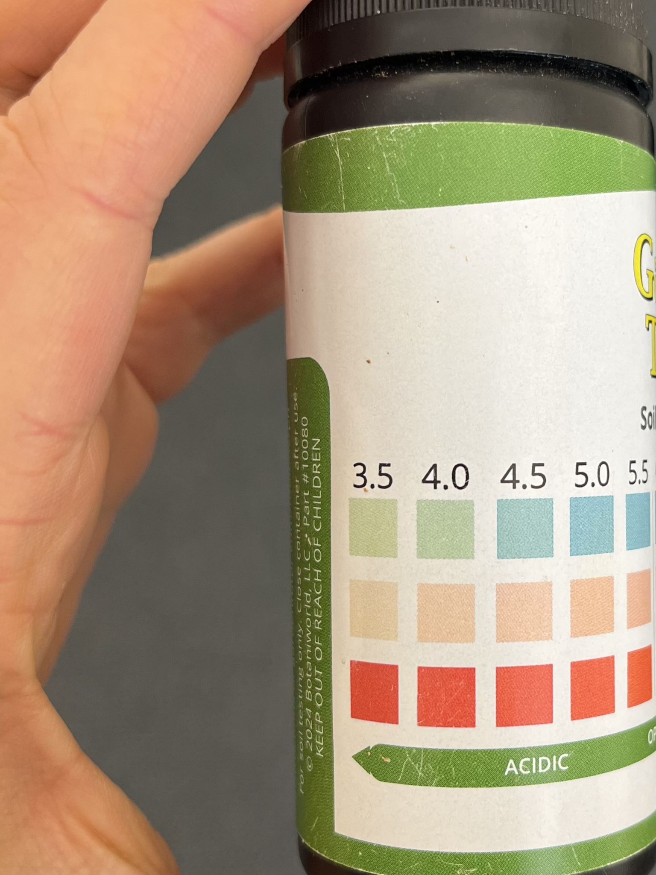
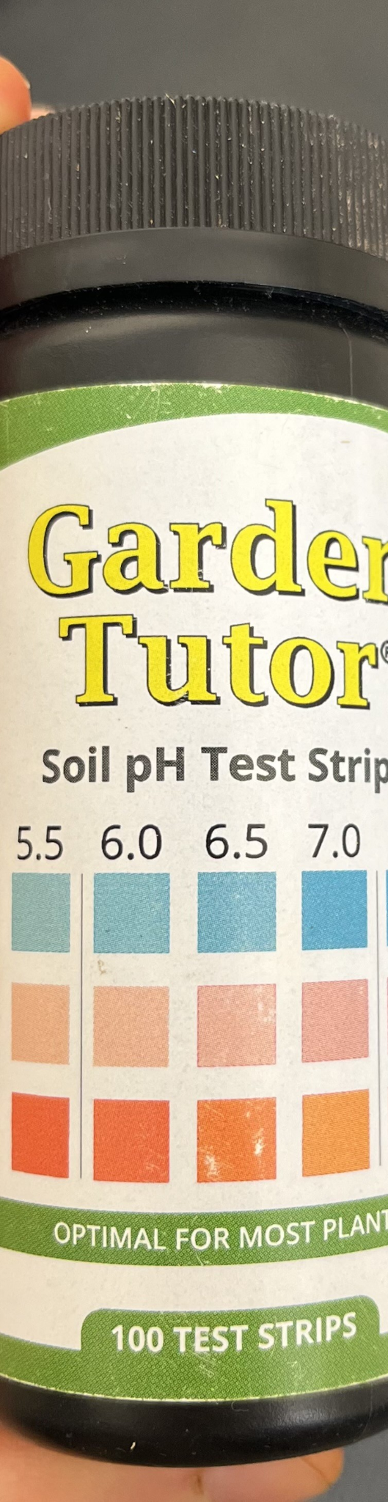
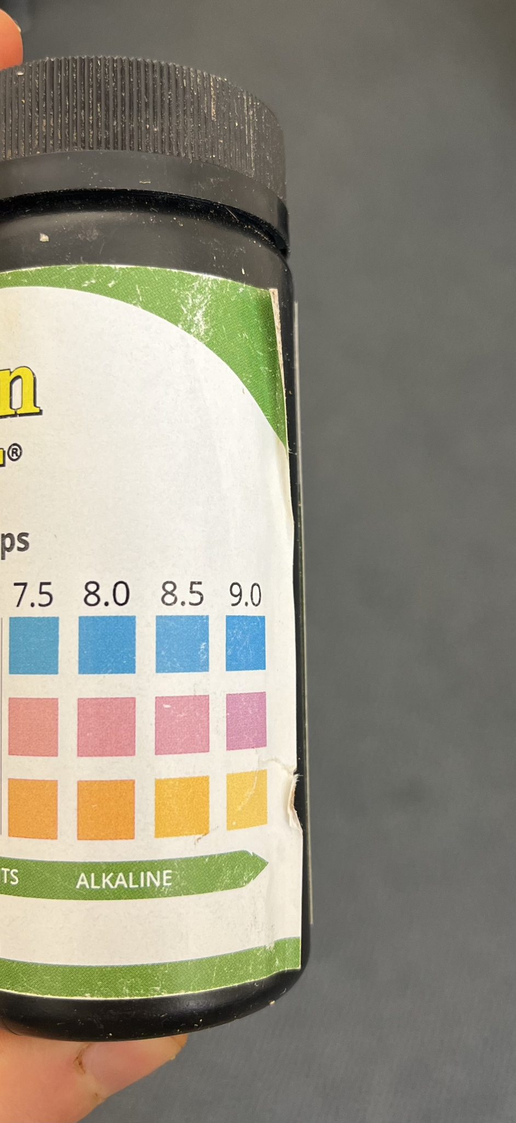
TEST 3: Soil pH
Neutral soil (pH 7) Acidic soil
Impacts nutrients & healthy plants
High pH (acidic) or low pH (basic) soils toxic to plants!
Ideal pH: 7 (neutral)
-Dip test strip in water
-Wait 60s
-Compare the color, record
Notes:
Soil pH is how acidic or basic a soil is: plants prefer soils with a neutral soil pH of 7, since soils that are too acidic or basic can be harmful to plants! Here’s a picture of two plants that were grown in different soils: which do you think grew in a neutral pH soil, and which in an acidic soil?
However, some plants can tolerate more acidic or basic soils. Here’s a chart showing the preferred pH ranges for different plants- which plant grows best in acidic soil?
TEST: Dip your test strip into the WATER of your soil slurry; don’t dip it into the soil that’s settled onto the bottom, since that will make it harder to read.

Slide 14
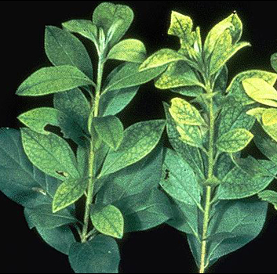
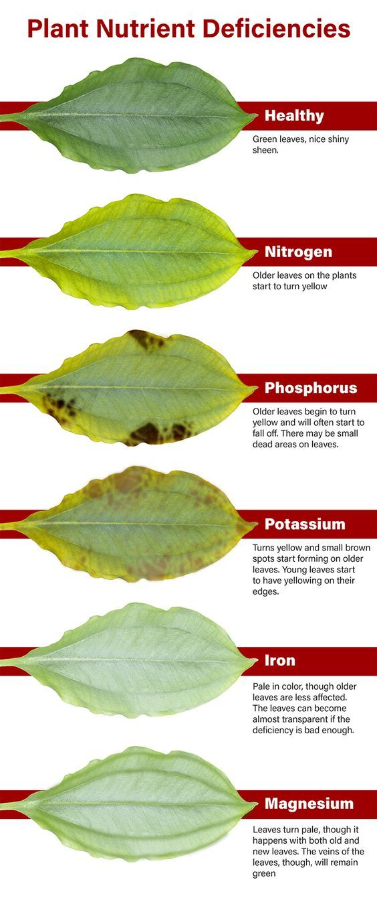
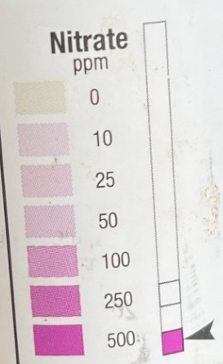
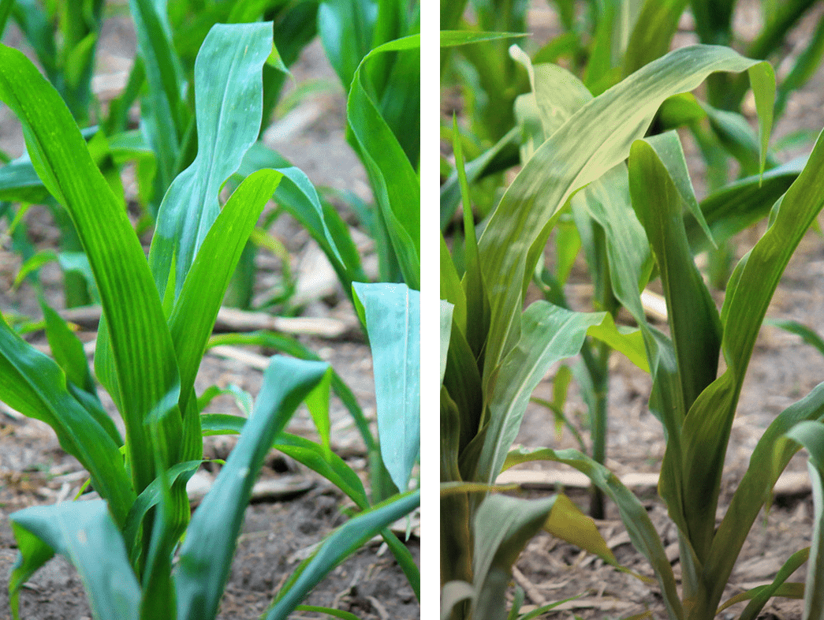
TEST 4: Soil Nitrate
-Plants get the nutrients they need to grow from the soil
-Nitrogen is usually the limiting nutrient!
Adding N: Fertilizer,compost, legumes
-Dip test strip in water
-Wait 30s
-Compare the color, record
Notes:
Can you guess which of these plants are low in nitrogen, and which have enough? How can you tell?
Being low in nitrogen or other nutrients can make it hard for plants to make chlorophyll, which is why their leaves turn yellow.
Look at all these signs of different nutrient deficiencies in plants!
Healthy plants are better able to resist pests & disease, making them more resilient.
TEST: Nitrate is a form of nitrogen that’s found in soils, so that’s what we’re testing for today. Dip your test strip. Ignore the upper test block for nitrite: nitrate is usually very low in soils. Compare the bottom block to determine the nitrate concentration.

Slide 15
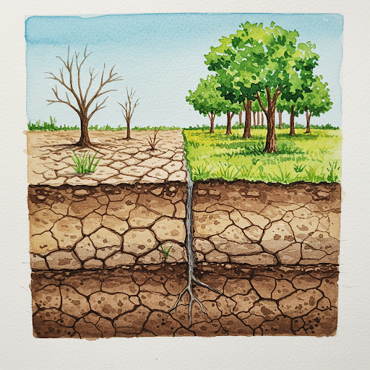
Do your measurements support your prediction of which soil was “healthy” and which was “unhealthy”? Why or why not?
How might the soil properties you measured help an ecosystem resist climate & weather threats?
Drought & floods
Heat & disease
Hail & wind
Notes:
Have students answer these questions in groups and record some ideas in their notebooks, then share with the class.

Slide 16
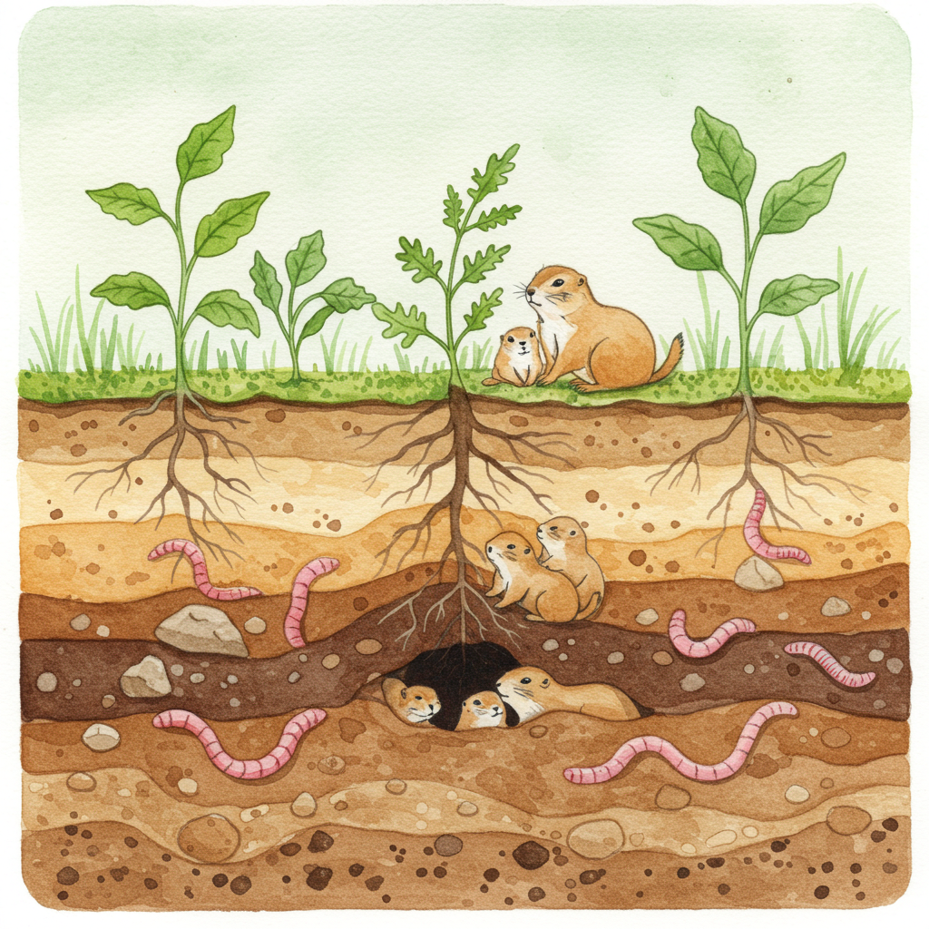
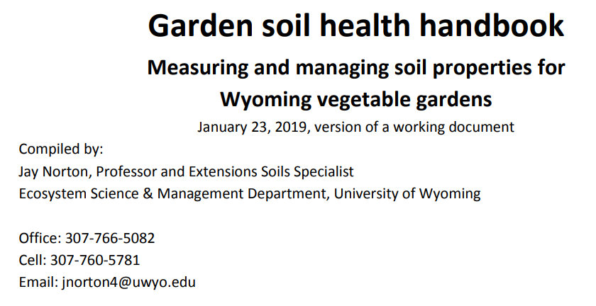

More Resources:
You can use this
workshop! Slides
& info here:
Created by Hannah Rodgers
Fall 2025

Slide 17
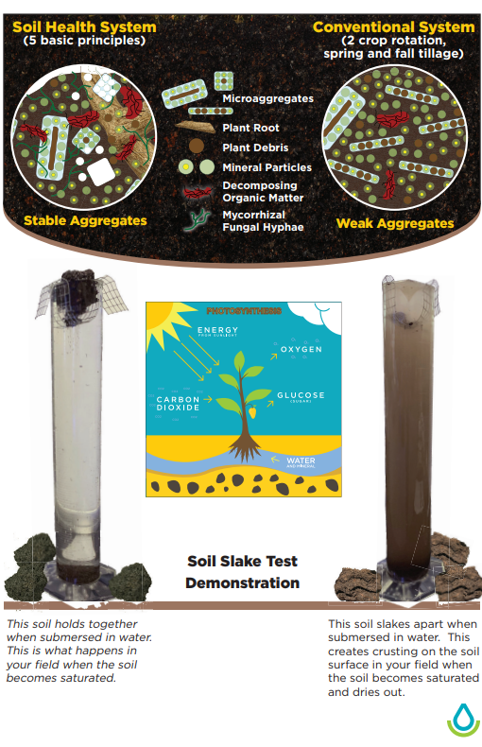
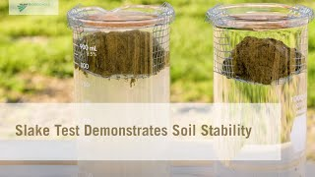
OPTIONAL EXTRA SLIDE:
Slake Test: Resisting Erosion
Notes:
THe slake test measures soil structure & aggregate stability! Stable soils won’t fall apart in water.
To just see the test, watch from 2:15 to 3:00

