Slide 1

Creating a Data Management Plan With DMPTool
Shannon Sheridan, MLIS
University of Wyoming
March 16, 2021

Slide 2
What is a data management plan?
“A data management plan (DMP) is a written document that describes the data you expect to acquire or generate during the course of a research project, how you will manage, describe, analyze, and store those data, and what mechanisms you will use at the end of your project to share and preserve your data.”
Source: Stanford Libraries
Notes:
DMP
sometimes also called a data sharing plan
When sensitive data are used, the DMP must also describe what steps you are taking to make your data secure and compliant with regulations.
A DMP might be informal, to be used internally, guided by policies established by the head of a research lab or collaborators. Some funding agencies or projects might require submission of formal DMPs. It is important during the course of a project to make sure that everyone on the research team is aware of where the data reside and how to access them, how they are organized and documented so they are readily usable by the team. DMPs can be updated and revised as needed during the course of the project - a DMP is a living document.

Slide 3
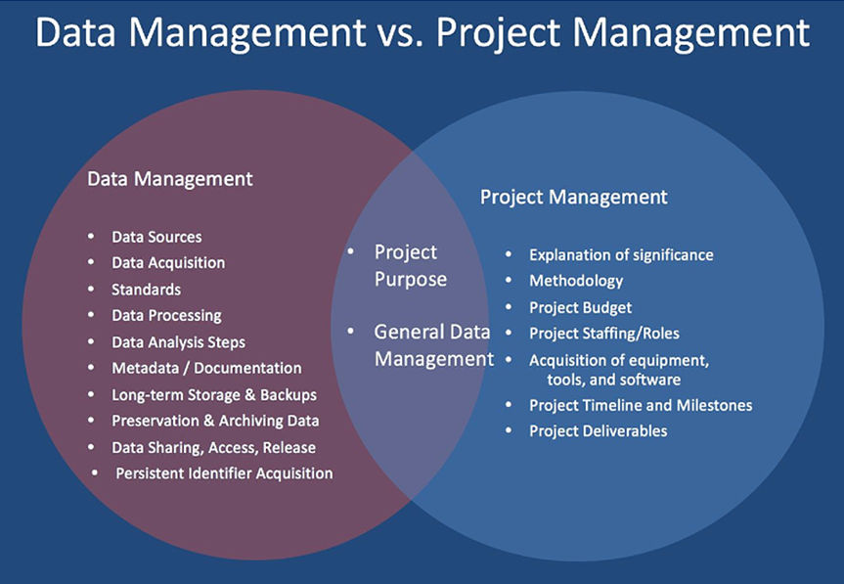
Data management is not project management

Slide 4
Reasons for needing a DMP
Meets specific data management requirements mandated by grant funding agencies.
Increases research impact and visibility by planning better data management practices.
Simplifies the research process to easily find your data when you need it.
Avoids duplication of data.
Saves you time which allows you more time to focus on your research.
Helps team members understand roles and responsibilities of various individuals, especially in teams involving partners from different organizations.

Slide 5
Elements of a DMP

Slide 6
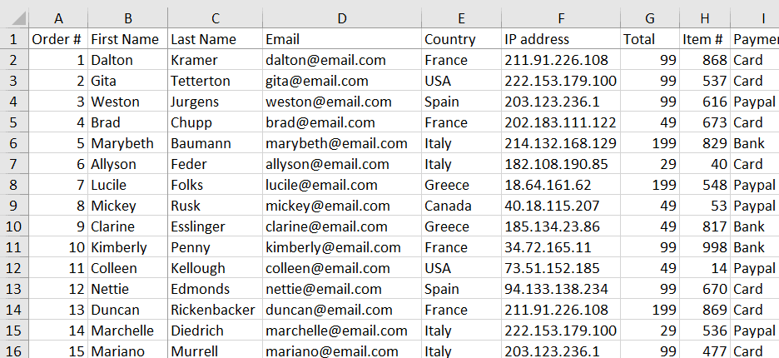
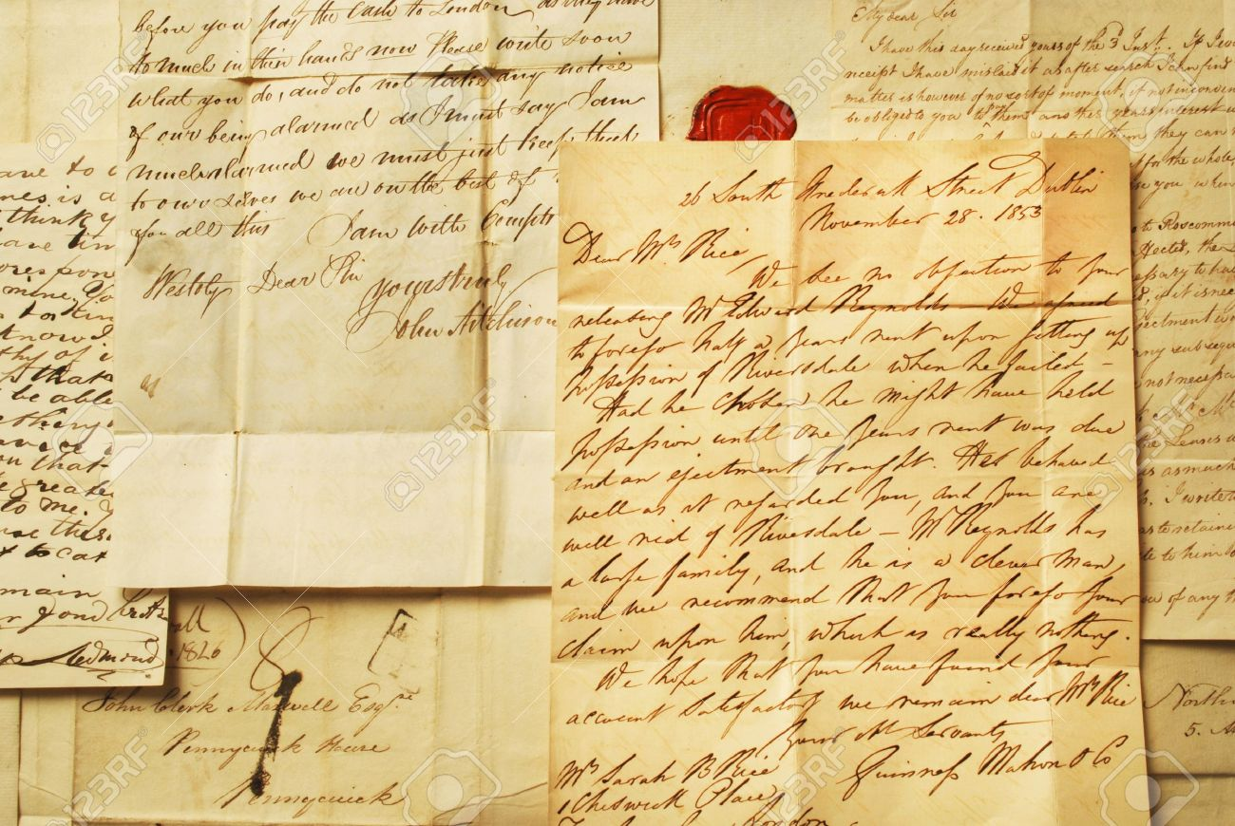
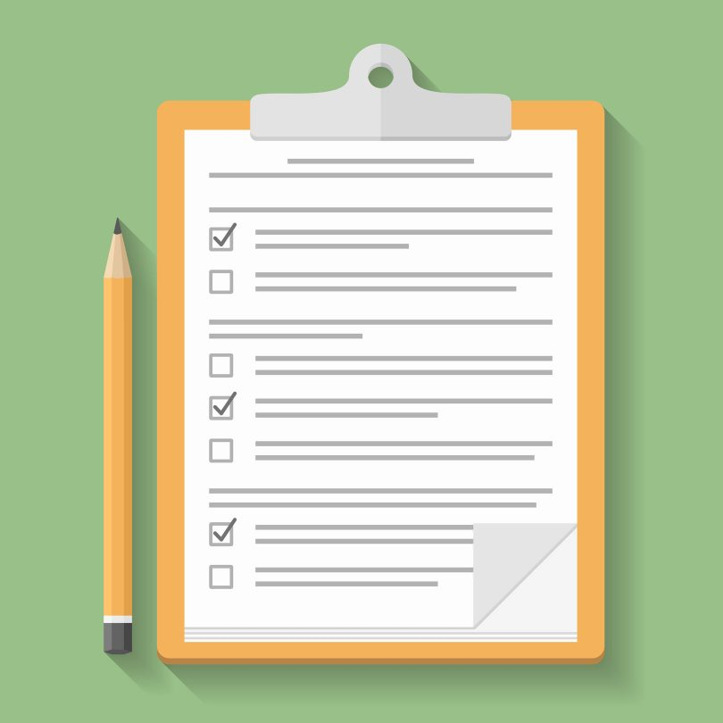
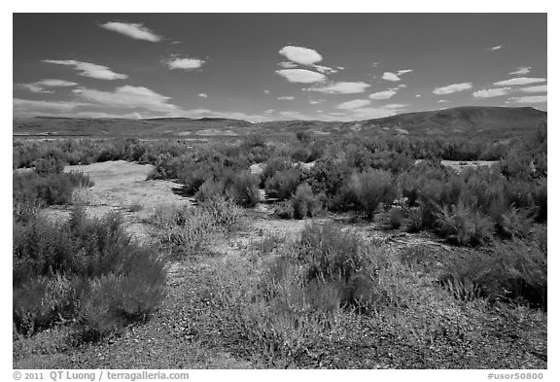
Data Description
Are there any existing data that you can reuse?
What standards or methodologies will you use to create data?
Do your chosen formats and software enable sharing and long-term access to the data?
How will you structure and name your folders and files?
What quality assurance processes will you adopt?
Notes:
Here you should consider what data you will collect and how.
Wide definition of data—can apply to all disciplines

Slide 7

Responsibilities and Resources
Who is responsible for implementing the DMP, and ensuring it is reviewed and revised?
How will responsibilities be split across partner sites in collaborative research projects?
What resources will you require to deliver your plan?
Is additional specialist expertise or equipment required?
https://medium.com/facebook-research/7-tips-for-collaborating-with-other-researchers-160ecc36e231
Notes:
Here you should assign roles and responsibilities for all data management activities. Also carefully consider any resources needed to deliver your plan. These costs can usually be written into grant applications but need to be clearly outlined and justified.

Slide 8
Storage and Backup
Do you have sufficient storage or will you need to include charges for additional services?
Who will be responsible for backup and recovery?
What are the risks to data security and how will these be managed?
How will you ensure that collaborators can access your data securely?
Where and how will you store your data to ensure their safety (several copies are recommended—the 3-2-1 rule)?
How will data be managed during the project? Include information about version control and file-naming conventions.
Notes:
Not the same as preserving! Here you should consider where the data will be stored and any implications this has for backup, access and security.

Slide 9
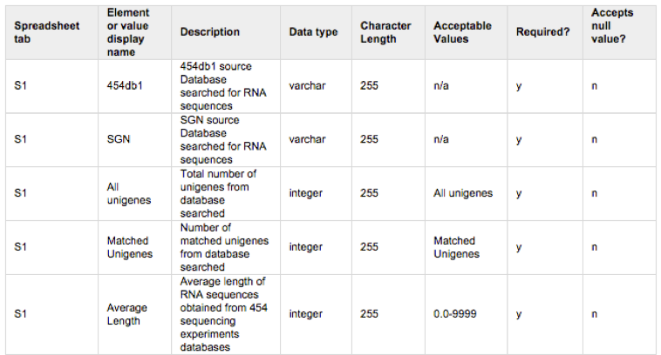
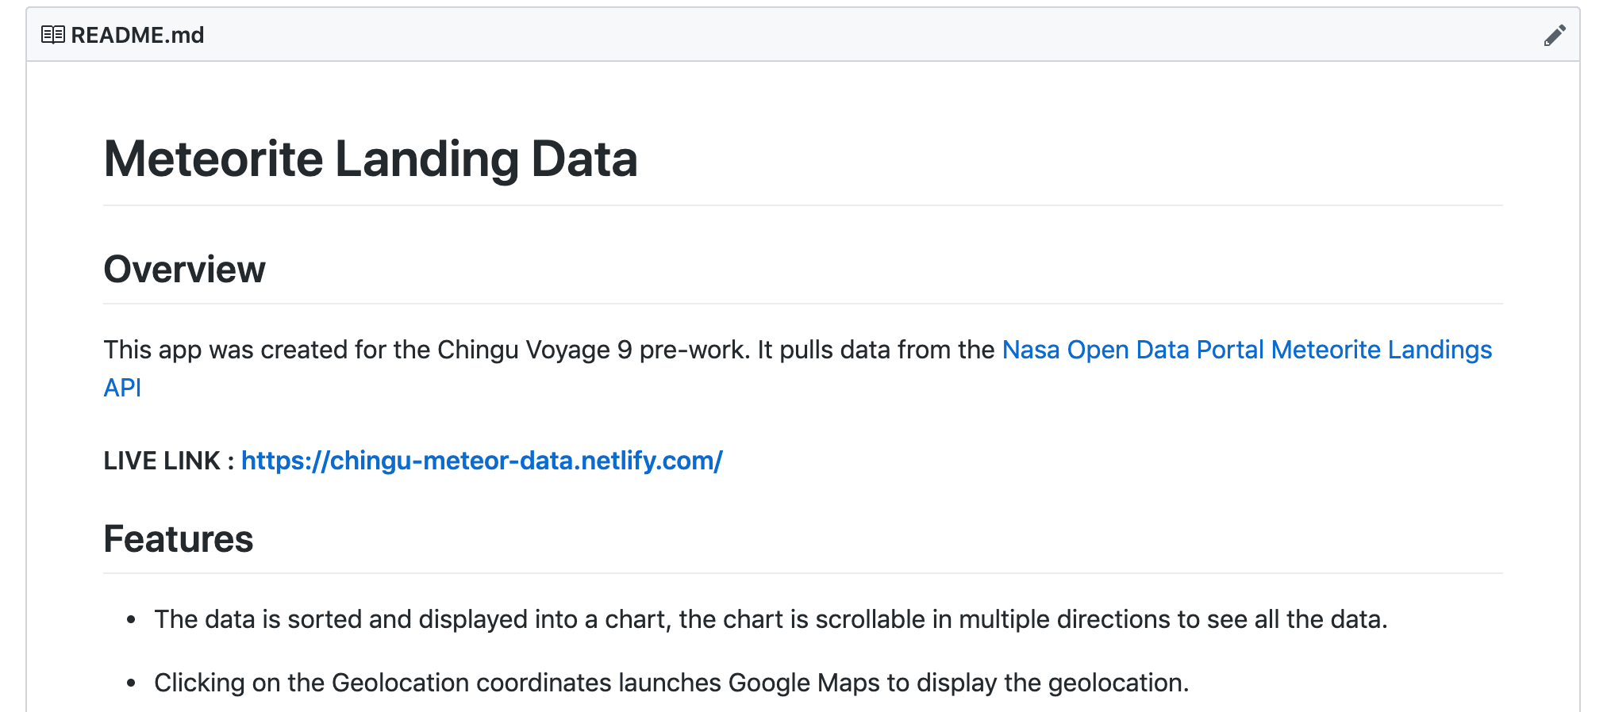
Documentation and Metadata
What documentation and metadata will accompany the data?
How will you capture / create this documentation and metadata?
What metadata standards will you use and why?
Don’t forget to include identifiers such as
Basic information e.g. project title, your name, contact details, reference numbers / IDs
A summary of the research to explain the purpose for which data are being collected
Details of related policies and procedures e.g. institutional data policy or departmental guidelines
https://medium.com/chingu/keys-to-a-well-written-readme-55c53d34fe6d
https://www.dataversity.net/what-is-a-data-dictionary/
Notes:
Here you should consider what information is needed for the data to be to be read and interpreted in the future. Estimate how much time and effort will be needed to create this supporting documentation and ensure that you allow for sufficient resource to cover this.

Slide 10
Intellectual Property Rights
Who will own the rights to the data and other information produced by the project?
Do you need a data use agreement?
Will any copyrighted materials be used?
How will permission be obtained to use and disseminate the data?
Will these rights be transferred to another organization for distribution and archiving?
Notes:
The transfer of data between organizations is common in the research community. When the data is confidential, proprietary, or otherwise considered sensitive, the organization providing the data (“Provider”) will often require that the organization receiving the data (“Recipient”) enter into a written contract to outline the terms and conditions of the data transfer. Such a contract is usually referred to as a Data Use Agreement (DUA), although it may also be referred to as a License Agreement, Confidentiality Agreement, Non-Disclosure Agreement, Memorandum of Understanding, Memorandum of Agreement, or other names if these agreements include data sharing or data transfer requirements.

Slide 11
Ethics and Privacy
Have you gained consent for data sharing and preservation?
How will you protect the identity of participants if required? e.g. via anonymization
Will data sharing be postponed / restricted? e.g. to publish or seek patents
How will the data be licensed for reuse?
Notes:
Here you should consider any ethical or legal issues, particularly in terms of restrictions they may place on data sharing.
This is also a step that can and should include the IRB process—for example, if you’re planning on sharing data, even if it’s anonymized, the IRB should be made aware of that
When considering sharing your data, consider the following
In the United States, data is not copyrightable (although a particular expression can be, such as a table or chart).
Data can be licensed. E.g., some data providers license data to limit how the data can be used (to protect the privacy of study participants or guide downstream use of data)
If you want to promote sharing and unlimited use of your data, you can make you data available under a CC0 declaration (https://creativecommons.org/share-your-work/public-domain/cc0) to make it explicit. There are other Creative Commons licenses (https://creativecommons.org/) with additional protection.

Slide 12
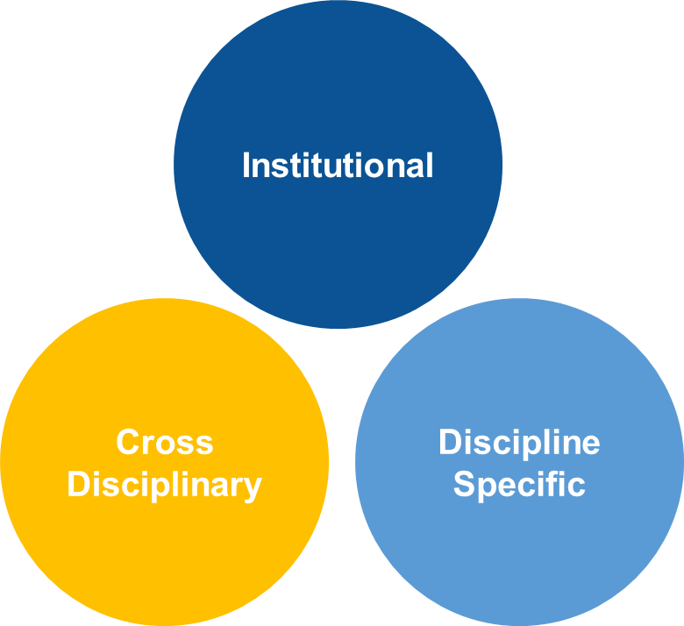
Access and Sharing
With whom will you share the data, and under what conditions?
When will you make the data available?
Are any restrictions on data sharing required?
What action will you take to overcome or minimize restrictions?
How will potential users find out about your data?
Repository Types
Notes:
Here you should consider which data you will share and how. The methods used will depend on a number of factors such as the type, size, complexity and sensitivity of the data. Also consider how people might acknowledge the reuse of your data (e.g. via citations) so you gain impact.

Slide 13
Archiving and Preservation
Which data must be retained or destroyed for contractual, legal, or regulatory purposes?
What are the foreseeable research uses for your data?
Which data should be preserved and potentially shared?
What procedures will you use to ensure long-term archiving and preservation of your data?
What are the budget costs of preparing data and documentation?
What format(s) will you use for the submission, distribution, and preservation?
Notes:
Here you should determine which data are of long-term value and should be preserved. Decide how best to preserve those data, for example by depositing in repositories.
Not all data is worthy of being retained forever
Some institutions have limits—Uwyo RDM policy spells out what is expected here

Slide 14
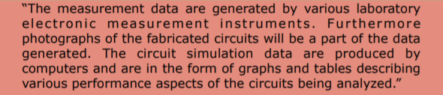
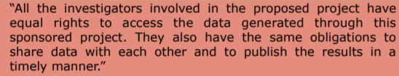


Qualities of a not-so-good DMP
Boilerplate
Vague
Lacks justifications
“By request only”
Data storage providers

Slide 15
So…what does it look like?
Doesn’t matter!
Okay, not entirely true.
If funders have a specification, use that format or file type.
But content and ease of use is more important than formatting.
That can translate into things like shared Google doc, part of an electronic lab notebook, even a physical notebook if that works with your workflow
Most important point is to use it and remember it is a living document

Slide 16
Resources
University of Michigan DMP template with advice and commentary
Digital Curation Center (DCC) DMP Guidance
DCC DMP Checklist
Ten Simple Rules for Creating a Good Data Management Plan
University of Wyoming Research Data Policy
DMPTool.org
Templates available on DMPTool

Slide 17
DMPTool

Slide 18
We’ll cover
How to log in to the University of Wyoming instance
Finding your grant agency
Filling out the template
Saving and/or printing
Using the University of Wyoming template

Slide 19
Live Demo

