Slide 1
Make it BEAUTIFUl Make it USEFUL
Creative Research Poster Design
UW Libraries’ Digital Scholarship Center

Slide 2
Hello!
I am Kristina Clement
Student Success Librarian, UW Libraries
kclemen8@uwyo.edu
Let’s introduce ourselves

Slide 3
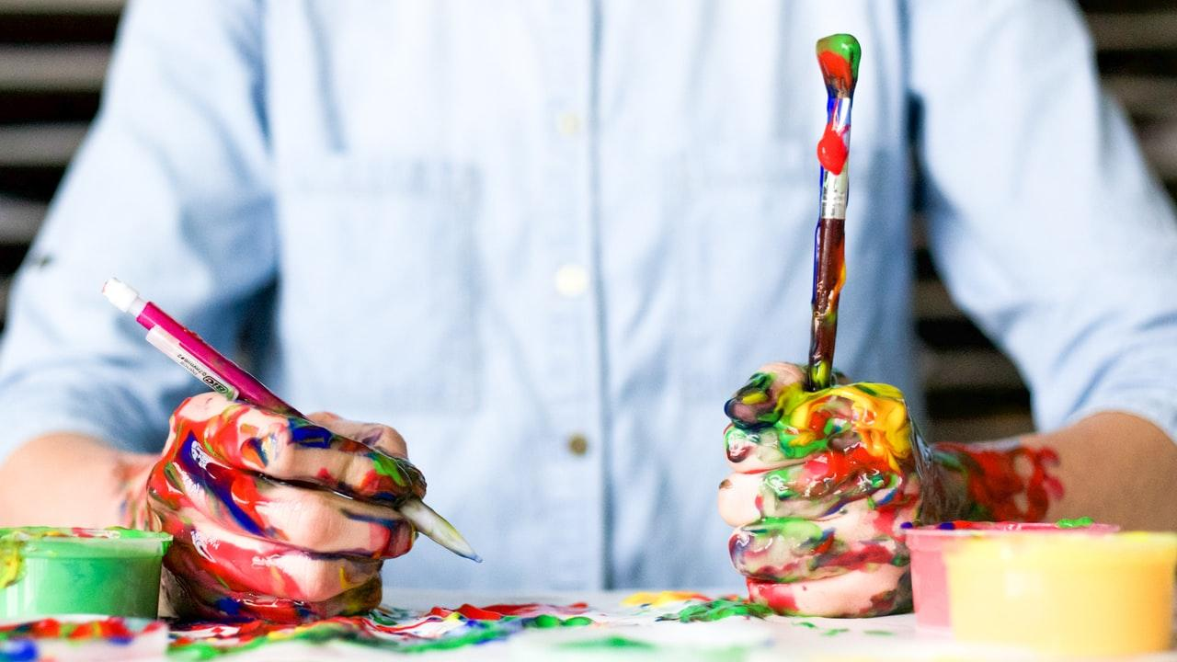
Today’s Agenda
Research Poster Basics
Content & Context
Recommended Practices
Example Posters
Graphic Design Programs & Tools
Practice and Play in the Graphic Design Sandbox
https://tinyurl.com/UWYOPosterWorkshop

Slide 4
1. The Basics
What is a research poster? When and why do we use them?

Slide 5
“The purpose of a research poster is to visually represent the general overview, data, and most relevant findings of a research project. Typically, research posters accompany an oral presentation of the project conducted, but should also be able to independently represent the research. The elements of a research poster include the abstract, the research questions, methodologies, results, and the conclusions. An effective research poster should provide a clean and consistent layout, emphasize research questions and results, utilize purposeful graphics and visuals, have readily accessible text, and include citations as well as contact information.”
Purdue Online Writing Lab,
https://tinyurl.com/PurdueOWLResearchPosters

Slide 6
Content & Context
Message
Who is your audience?
What do you want to communicate to the audience?
What’s the most important take-away?
Medium
Where are you presenting (conference, class, etc.)?
What delivery method makes the most sense?
Will it be online or in person?
Materiality
Why is this information important to present?
Why is your research relevant to your field of study?
What’s the bigger picture?
Notes:
Content and context are important things to consider when designing a research poster, but even more so when you’re trying to design one that is visually appealing and communicative.
Message = who is this for? Who will be reading it? What do you want them to know?
Medium = how will you be presenting your work? Do you have the option of choosing your format?
Materiality = the actually content on your poster. Why is it important? How can you convey the importance and relevance of your work on the poster?

Slide 7
Let’s Think About: Message
Message and Content
  Amount of text
  Amount of images and other visual elements
Message and Design
  Can it be visually appealing and still be informative?
Notes:
A couple notes about the message that you are sending with your poster and how it affects the content
For your message and your content:
Balance of text, images, and other visual elements (icons, graphs, charts, etc.) -- the amount of each of these things on your poster can either boost your message or detract from it.
For your message and your design:
Very similar in the sense that your design is how you tell your story. Can you be visually appealing and still be informative?
Visually appealing can be a lot of different things. It doesn’t have to be a perfect graphic design job. It could be as simple as things being neat, clean, and aligned. That’s very pleasing to the eye and very professional.
If you happen to have an eye for things like color and design, you might take your visuals even further. But, even if you don’t have an eye for color and design, several of the tools that I’m going to show you and let you play with later do a lot of that for you.

Slide 8
Recommended Practices
Dimensions
Standard dimensions for research posters tend to be 48”x36”. But, be sure to check guidelines and requirements for the conference or class. Sometimes they are closer to 40”x36”.
Layout
Traditional layout is to divide the poster into thirds and work from left to right. But, sometimes, you can get more creative with this. Do keep in mind that the eye tends to go from left to right.
Font
Font size, color, and style should be chosen carefully. You can use up to 2-3 different ones, but make sure they complement one another. Headers with a sans serif font are often best and most readable
Alignment
Many of the graphic design tools you can use for your poster help you align your content to make it neater and more professional.
Images
If you use stock photography on your poster, make sure you are within the bounds of fair use. Additionally, try to use images with at least 150+ dpi (1200 pixels).
Accessibility
Take into consideration the colors you are using on your poster and make sure they are accessible. If your poster is digital, add alt-text to your images.
Notes:
Here are some recommended practices that I’ve discovered over the years as I’ve made my own research posters.
Next, I want to show you some of the posters that I’ve designed over the years, starting with my very first one. Fair warning, some of these are good, and others are not. I have definitely learned as I went and I expect that I will keep learning.

Slide 9
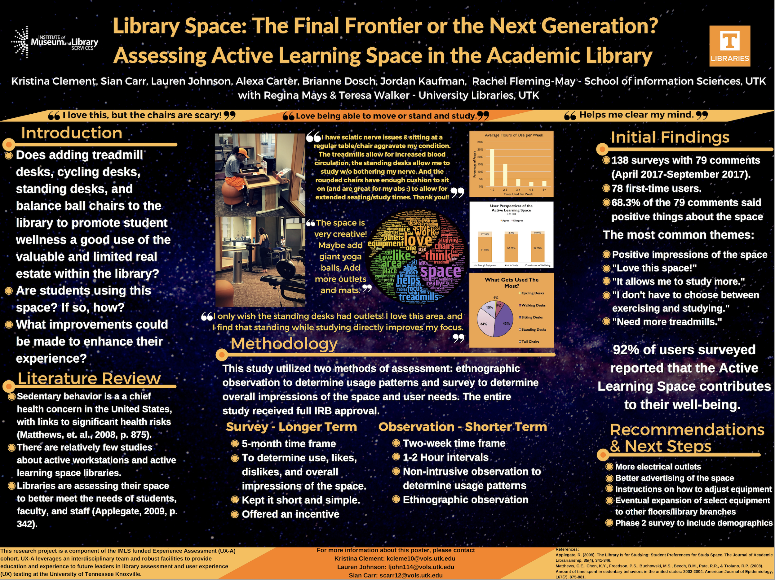
Notes:
This was my very first poster. I made this in 2017 while I was studying for my Masters in Information Science at the University of Tennessee. We presented this at a national conference, and while I knew nothing about making posters at this point, I did know that I wanted it to be visually appealing and really catch the eye. And while I think it is eye-catching, it definitely breaks a lot of the rules. There’s too much text, some of the text is really tiny (even though when it was printed full-size it looked okay--but, if you want to have a digital file to share, you need to consider the size of the smallest text on your poster), I wasn’t as good as using some of my favorite graphic design tools back then as I am now (though to be fair, I used Canva for this one and it was still in its first iteration. It has since moved on to version 2.0, which i like much better). I also didn’t take into consideration any accessibility standards for this poster.
There’s a lot I could have done better with this one, but I am still relatively proud of how it turned out. I also had full graphic design control within my group of researchers. No one else wanted to help with the design so they let me do it all and they provided feedback. That made it easier to realize my vision.

Slide 10
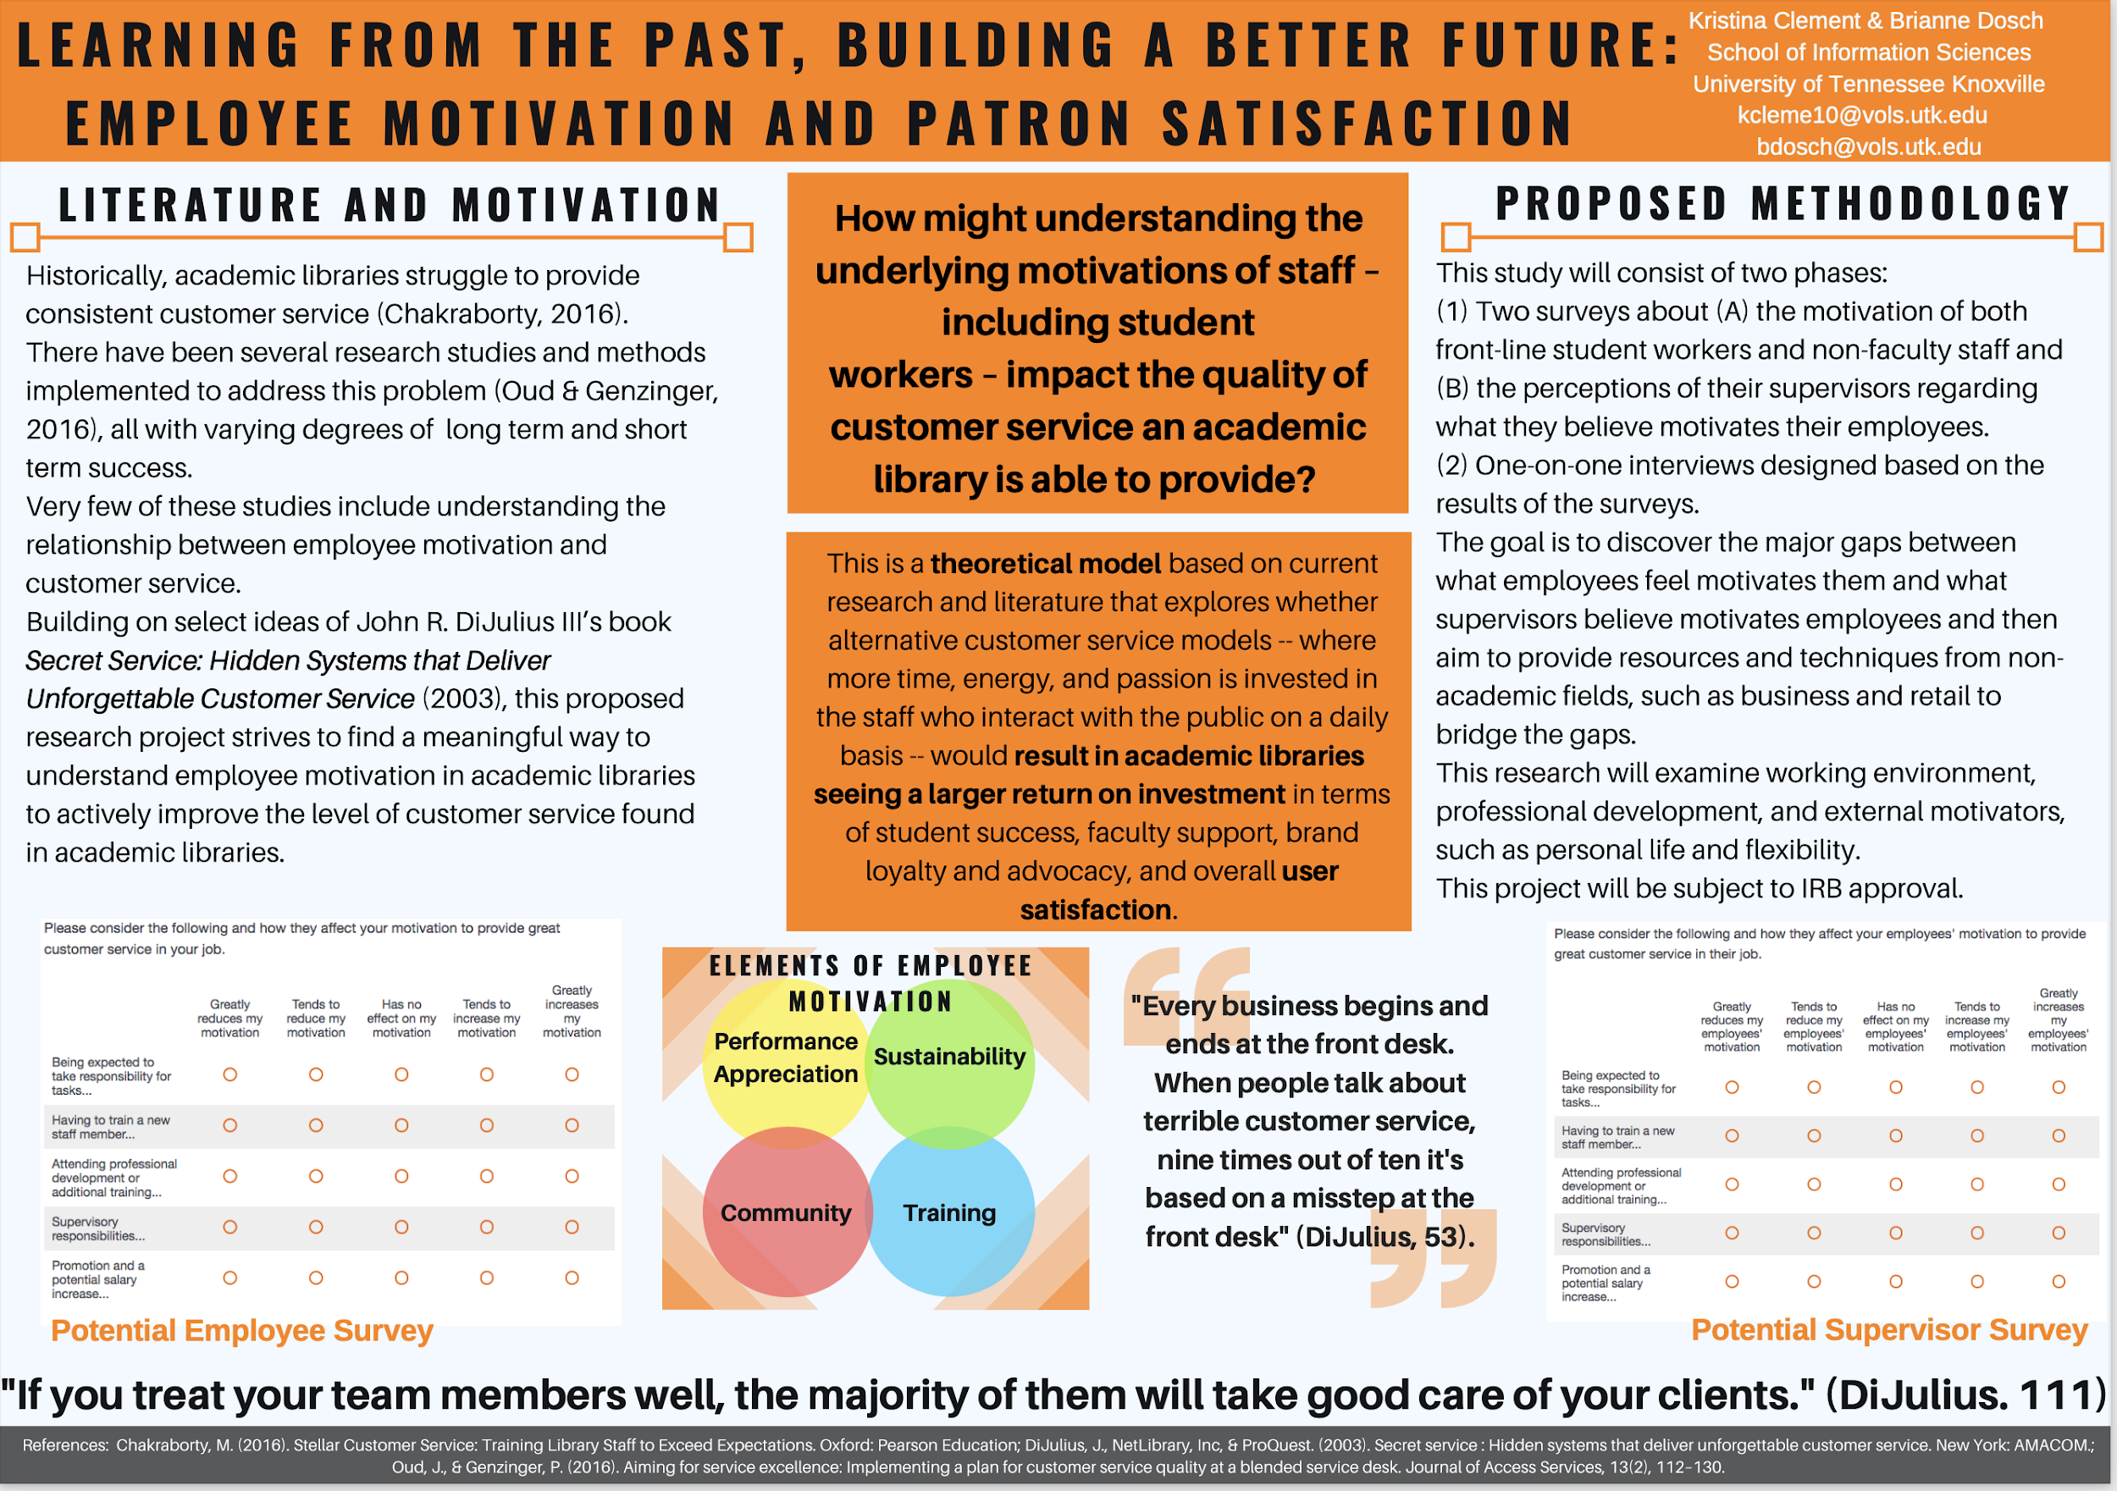
Notes:
This was the second poster I ever designed, and I was designing it for the same conference as the previous poster, so I was equally very new at this. I also designed this poster with my co-researcher and we both had an active hand in the graphic design. This is probably the poster that I like the least of all the ones I’ve designed. Generally, it’s okay, but I really like things that pop and that are pretty.
I should also note that this poster, and the two that follow it, are all part of the same research project. We were able to split the project into three distinct parts: the proposed methodology and theoretical model for this poster, the actual survey and methodology for the next poster, and for the third poster, the survey results and findings.

Slide 11
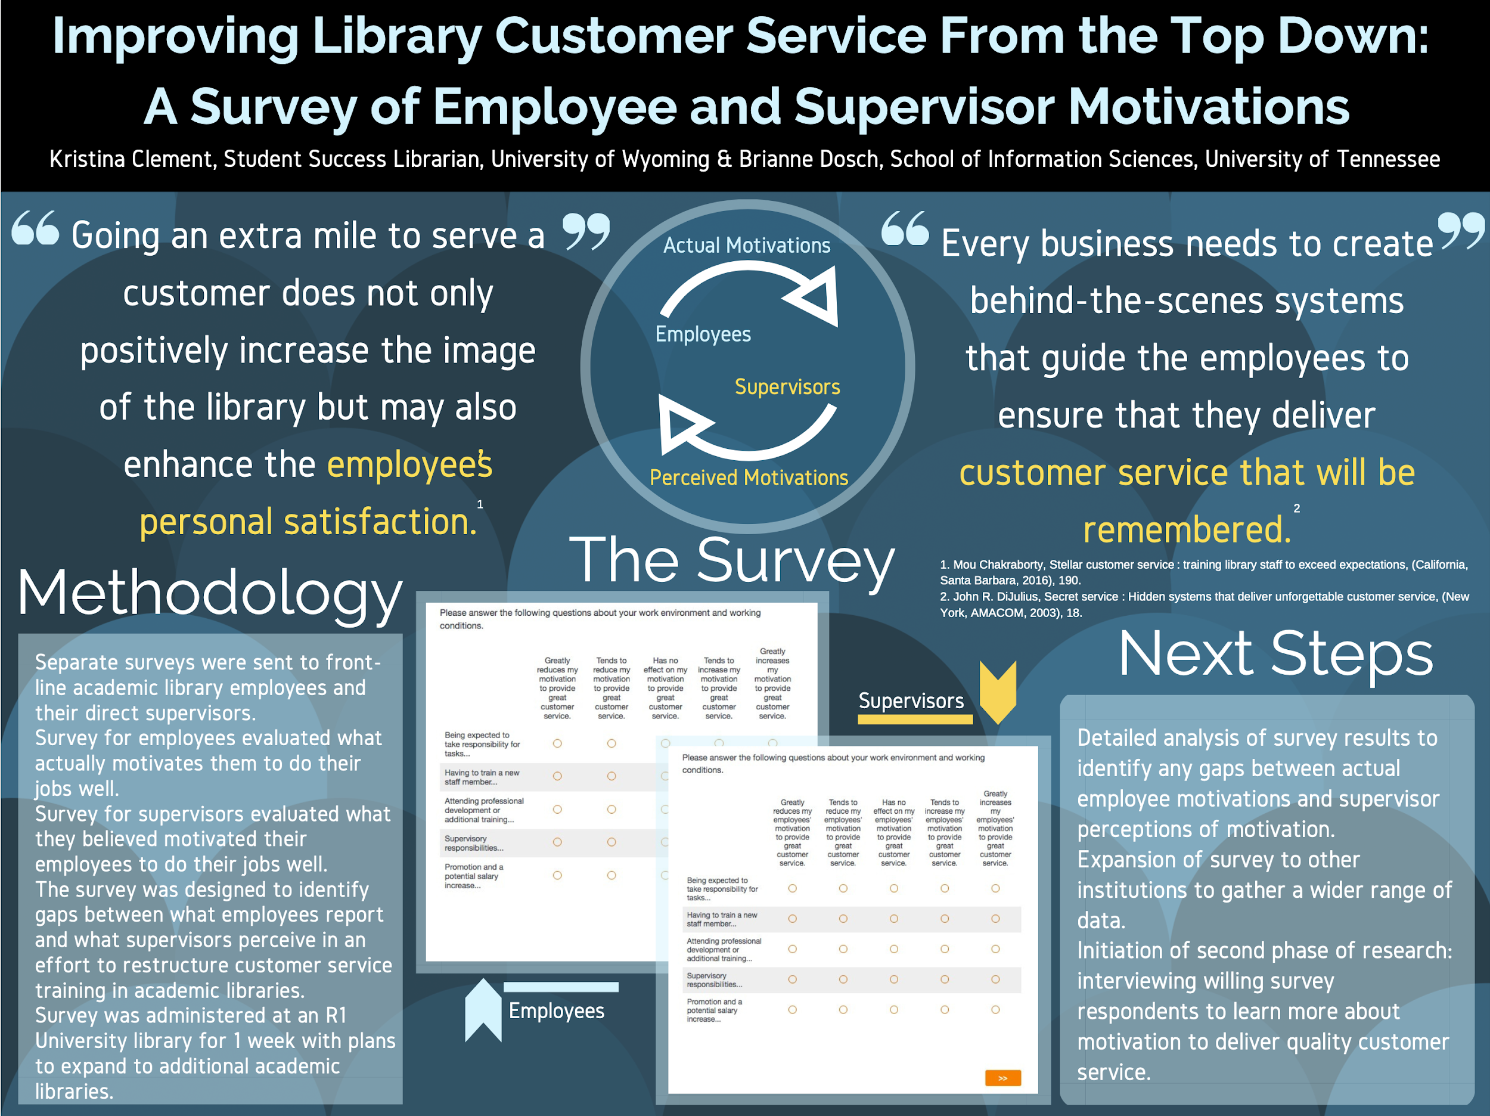
Notes:
This one was designed for a conference a year after the first two and by then I had used Canva a lot more and was more confident in my ameature graphic design skills. I think that this one looks much more visually appealing.
I often enjoy picking contrasting colors because they tend to pop, so here we did a blue and yellow combination that I quite liked.

Slide 12
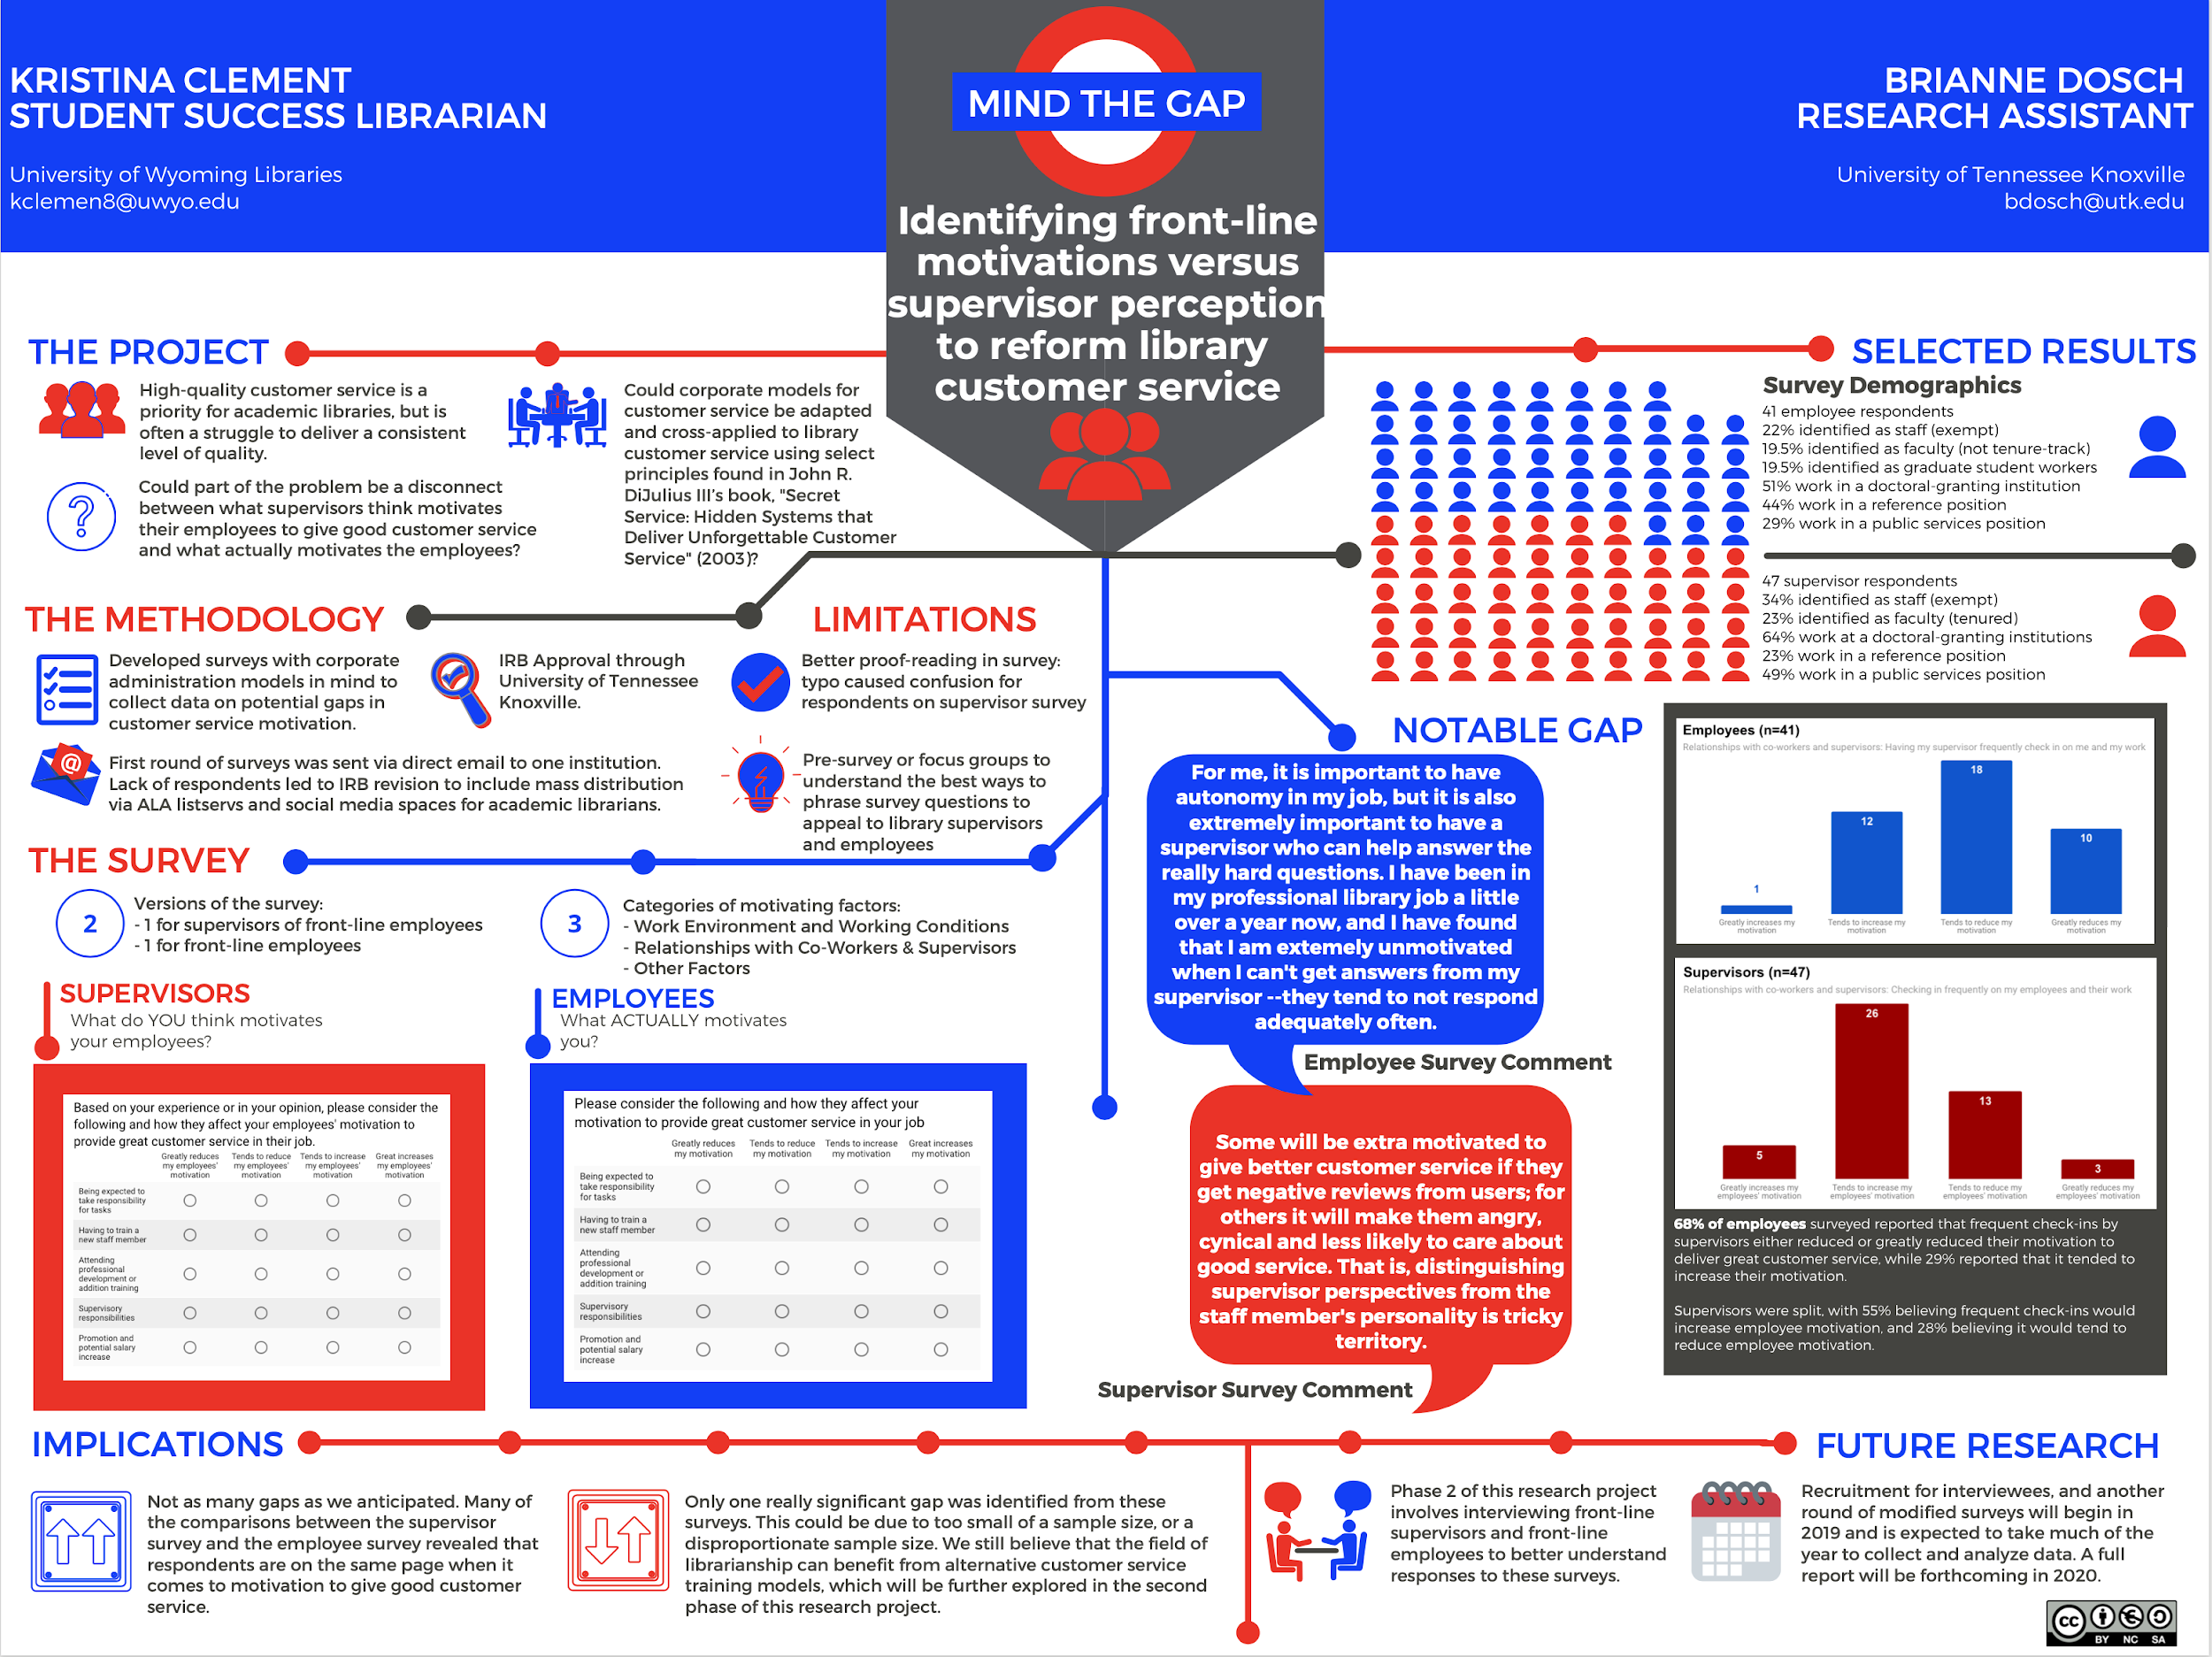
Notes:
This one is probably my favorite one, because I really can’t resist a punny title and a poster theme that goes along with it. And sometimes that’s one of my major design flaws because I am not entirely sure this poster would pass an accessibility check. But, I love it anyways. It has a London metro theme, which goes along great with our title, Mind the Gap (which, in case you don’t know, is a phrase that is played on repeat at the london subway stations so that travellers know that there’s a bit of a gap between the subway car and the platform).
This poster is about half text and half visual elements--give or take. I designed this one from scratch in Canva and I was pretty pleased with what I came up with. It still follows most of the poster rules, but I got to put my own visual twist on it.

Slide 13
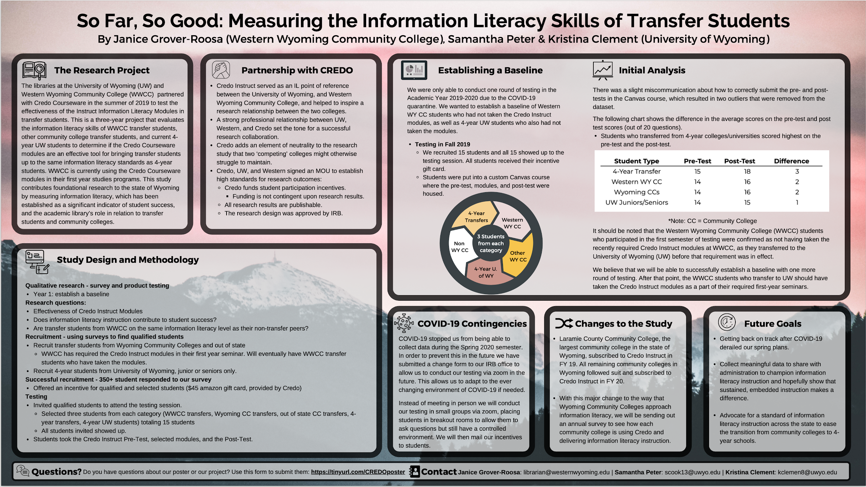
Notes:
This one is a little more traditional because it has the different boxes with the different steps in the research project. And, that made sense for this poster because the research project is a more traditional one. This poster was made for an online conference, so we were not limited to a particular size, and we even could have added more pages or other visual elements, but it didn’t make sense for the message we were trying to convey about our research. This particular point in the study was about establishing a baseline for comparison with future research, so we wanted it to be straightforward and informative.
My biggest problem with this poster is that it is very, very text heavy. Far more text than I would normally use, but again, because of the nature of the project and where we were with it at the time, there just wasn’t a lot of visual elements we could have added. And that’s okay. Not every poster you design will be a work of visual art. Sometimes straightforward and simple is the way to go. Despite this being a text-heavy and simple poster, I still think it’s rather beautiful.

Slide 14
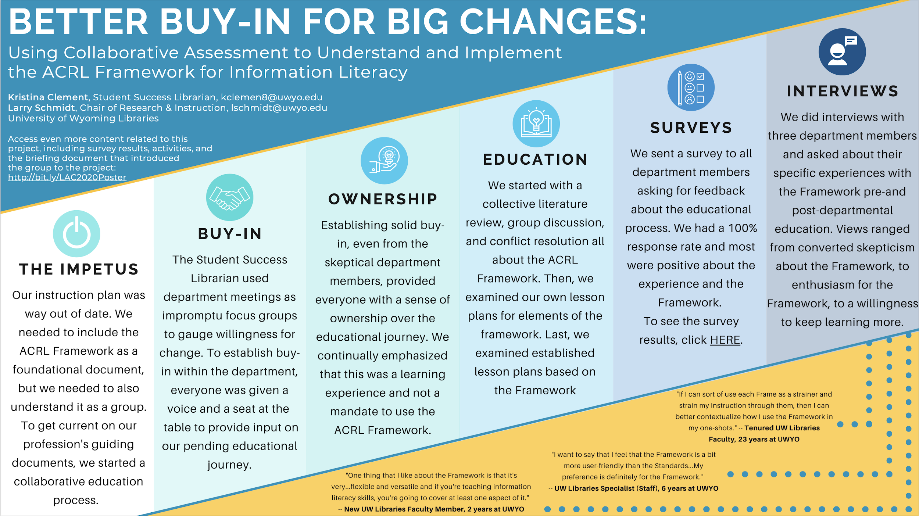
Notes:
This is my favorite poster thus far, and one that I made last fall for an online conference. Technically, it’s really text heavy, but somehow it doesn’t look like it because of how it’s designed. In fact, the conference used this poster to promote the virtual poster session, and I imagine it was because it was one of the more visually appealing ones.
To create this one, I actually used a pre-designed presentation template in Canva and I selected one particular slide to work with. This was the result. And, as you might be able to see in a couple spots, there is a link to more materials related to the poster’s topic. Virtual conferences are great for this, because you get the chance to link out to any number of resources.

Slide 15
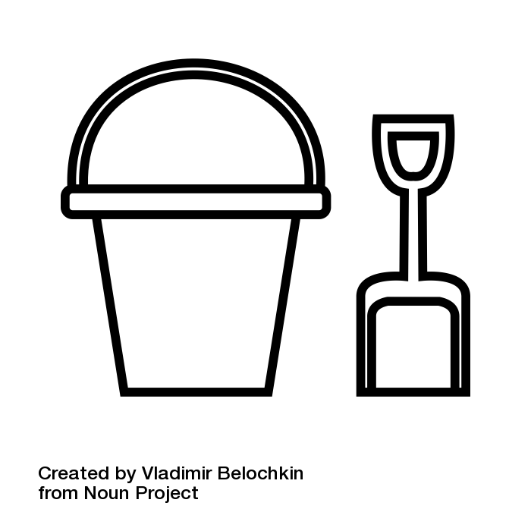
Let’s Go Play in the Sandbox
https://padlet.com/kclemen3/Sandbox

Slide 16
Thanks!
Any questions?
You can find me at:
kclemen8@uwyo.edu
Evaluation: https://forms.gle/iTKHi8BF8xQ5JNCj6

Slide 17
Credits
Special thanks to all the people who made and released these awesome resources for free:
Presentation template by SlidesCarnival
Photographs by Unsplash

